Slide 1
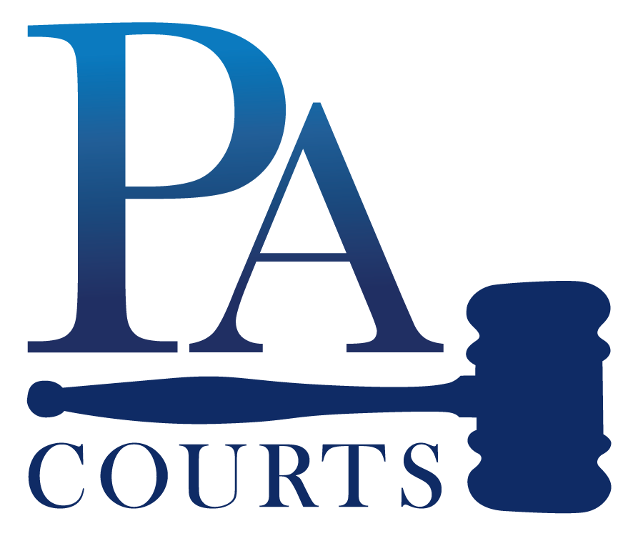
Constitution Day: History & Significance
Did you know that Sept. 17, 1787, was the day the U.S. Constitution was signed? This important moment laid the foundation for our nation's laws and governance.
On this historic day, delegates gathered right here in Pennsylvania – specifically in Philadelphia – to craft a document that would shape the future of America.
The Constitution was born, which is the big set of rules for our country.
This day also commemorates all who are or have become U.S. citizens and highlights the importance of constitutional principles.
Video: Constitution Day
Independence Hall in Philadelphia
THE UNIFIED JUDICIAL SYSTEM OF PENNSYLVANIA

Slide 2
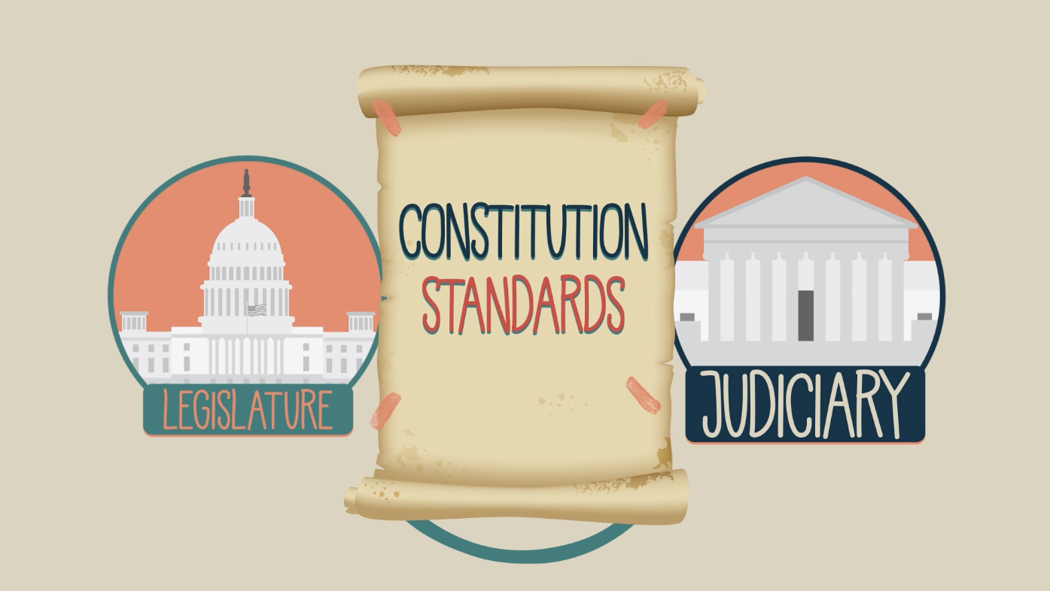
Why is Constitution Day Important for Judges?
Judges uphold, interpret, and defend constitutional principles, ensuring justice is administered impartially.
The judiciary protects rights spelled out in the federal and PA constitutions, which are the backbone to democracy.
Judges help people understand the importance of the Constitution in our daily lives, ensuring justice and equality for all.
The Constitution isn't just a historical document; it actively influences modern laws and rights.
Video: The Role of Pennsylvania Courts in a Democracy
THE UNIFIED JUDICIAL SYSTEM OF PENNSYLVANIA

Slide 3
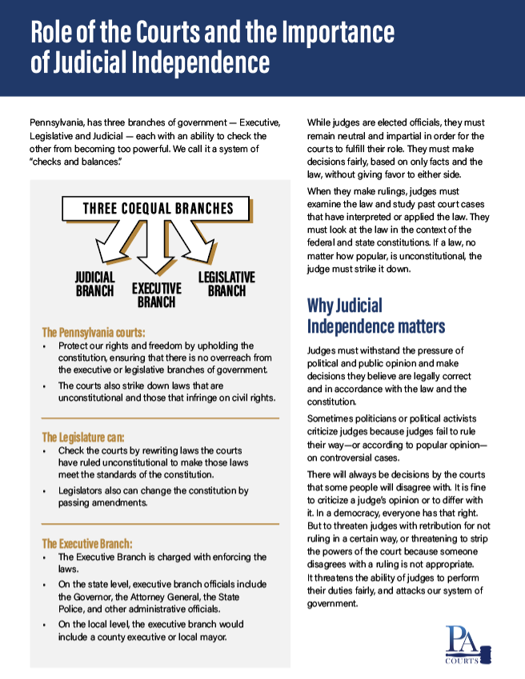
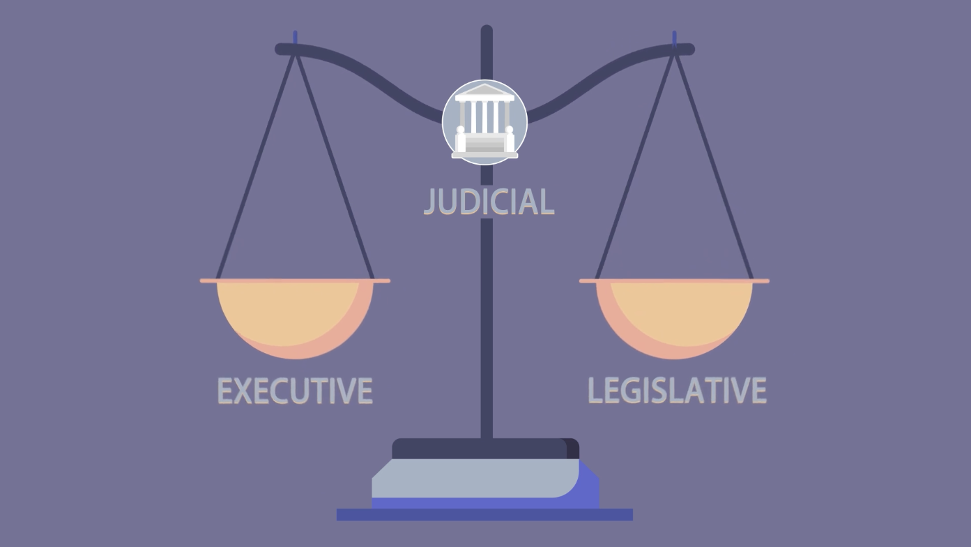
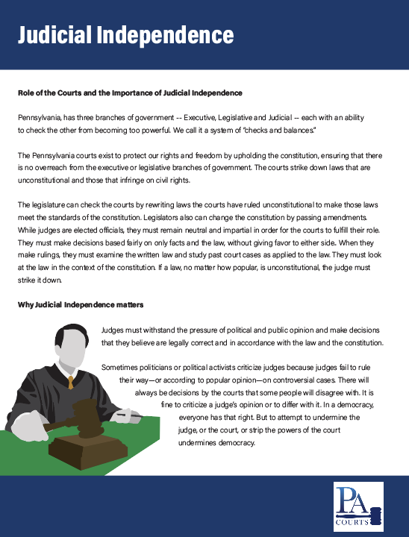
Judicial Independence and The Rule of Law
The Constitution guarantees separation of powers to ensure courts remain independent and impartial.
Infographic: Role of the Courts and the importance of Judicial Independence
Judges must resist political pressure and public sentiment, focusing on equal justice for all, as the founding fathers intended.
Judicial independence is essential for maintaining trust in the legal system.
Infographic: Judicial Independence
Video: Why Judicial Independence Matters
THE UNIFIED JUDICIAL SYSTEM OF PENNSYLVANIA

Slide 4
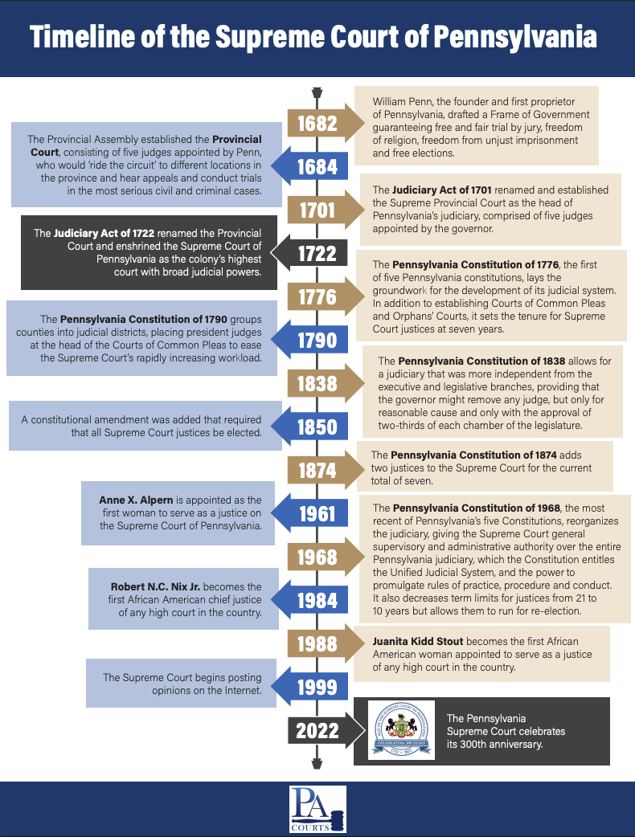
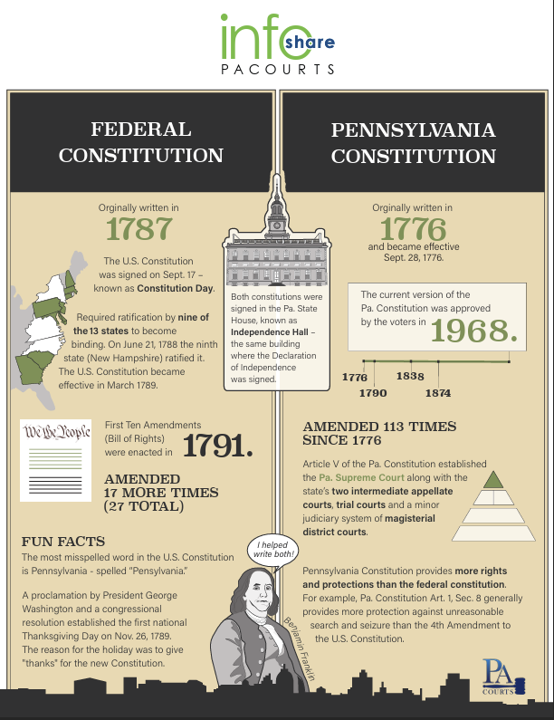
Pennsylvania’s Constitution: A Living Document
The PA Supreme Court is the oldest appellate court in the country, established in 1722.
Pennsylvania’s constitution has evolved, most recently with the Constitution of 1968, reflecting state-specific rights and jurisprudence.
The PA Supreme Court reviews statutes under state constitutional provisions—distinct from federal ones.
Infographic: PA Supreme Court Timeline
Infographic: Federal vs State constitution
THE UNIFIED JUDICIAL SYSTEM OF PENNSYLVANIA

Slide 5
Methods of Constitutional Interpretation
Judges use multiple approaches:
  Textual: Meaning of the words.
  Historical: Context during drafting.
  Precedent: Applying previous rulings.
  Structural: Analysis of institutional relationships.
  Prudence: Weighing consequences and limits of judicial power.
  Natural Law/Morality: Principles of fairness and morality.
THE UNIFIED JUDICIAL SYSTEM OF PENNSYLVANIA

Slide 6
Civic Education & Community Engagement
Constitution Day isn't just a date on the calendar; it's a reminder of our civic duties.
Constitution Day is an opportunity to educate everyone about the Constitution’s role and the judiciary’s responsibilities.
Because of the Constitution, we have rights, responsibilities and a government that is responsible to the people.
By honoring this day, we remember our rights and responsibilities as citizens – for example, the right to vote,
to speak up and to follow our own beliefs.
Happy Constitution Day!
Interactive Quiz
THE UNIFIED JUDICIAL SYSTEM OF PENNSYLVANIA

Slide 7
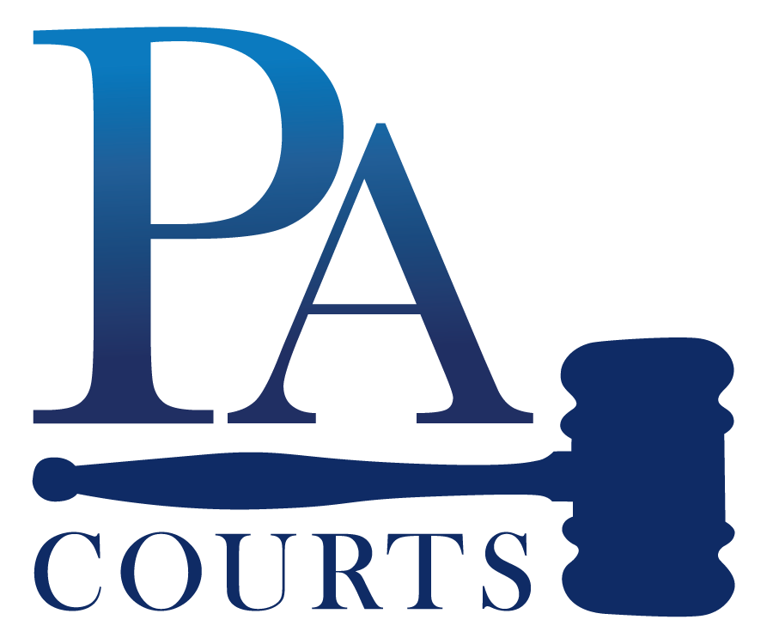
For additional resources, check out the Pa Courts’ civics education toolkit at www.pacourts.us/civics-ed
THE UNIFIED JUDICIAL SYSTEM OF PENNSYLVANIA

