Slide 1
Constitution Day
Constitution Day celebrates the signing of the U.S. Constitution
on Sept. 17, 1787.
Video: Constitution Day Animated Video
Independence Hall in Philadelphia

Slide 2
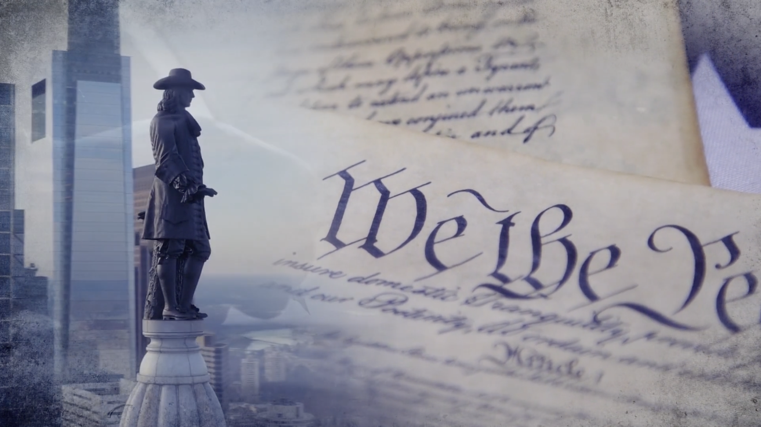
What is the Constitution
It’s a set of rules for how our country is run.
Think of it like the “rulebook” for the United States.

Slide 3
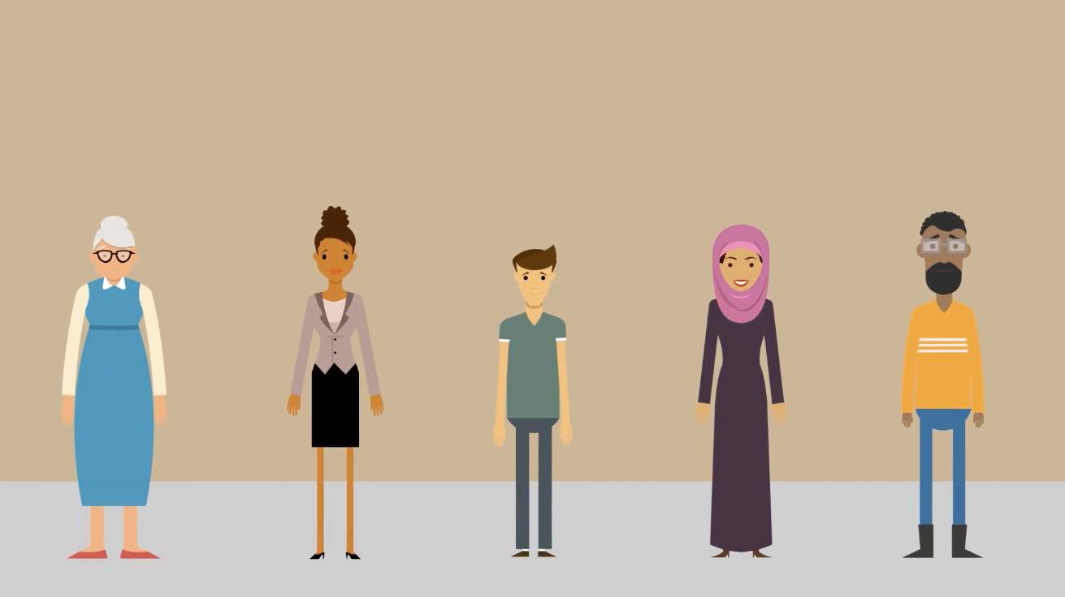
It makes sure everyone is treated fairly.
Sets up important rights for all people living in America.
A judge is like a referee in a game, but for laws that everyone follows. When people disagree or break a rule, the judge listens to both sides, looks at the facts, and helps everyone understand what should happen next.
So, judges help people solve problems according to the rules, and the Constitution makes sure those rules keep us safe and free.
Why do we need it?

Slide 4
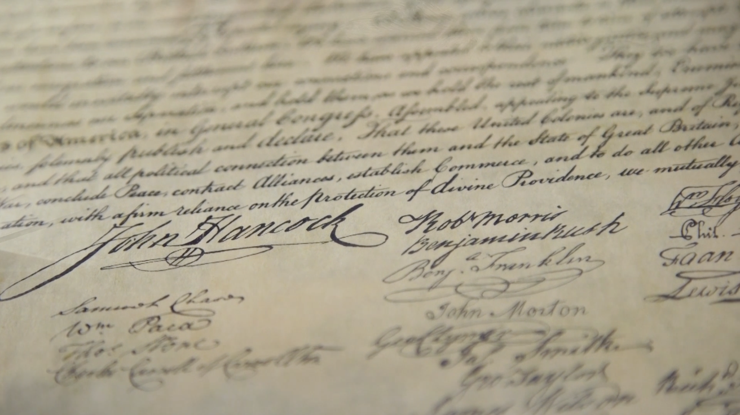
It was written in 1787 by leaders from the first states.
These leaders wanted a country where people make the rules, not kings.
Who created it?

Slide 5
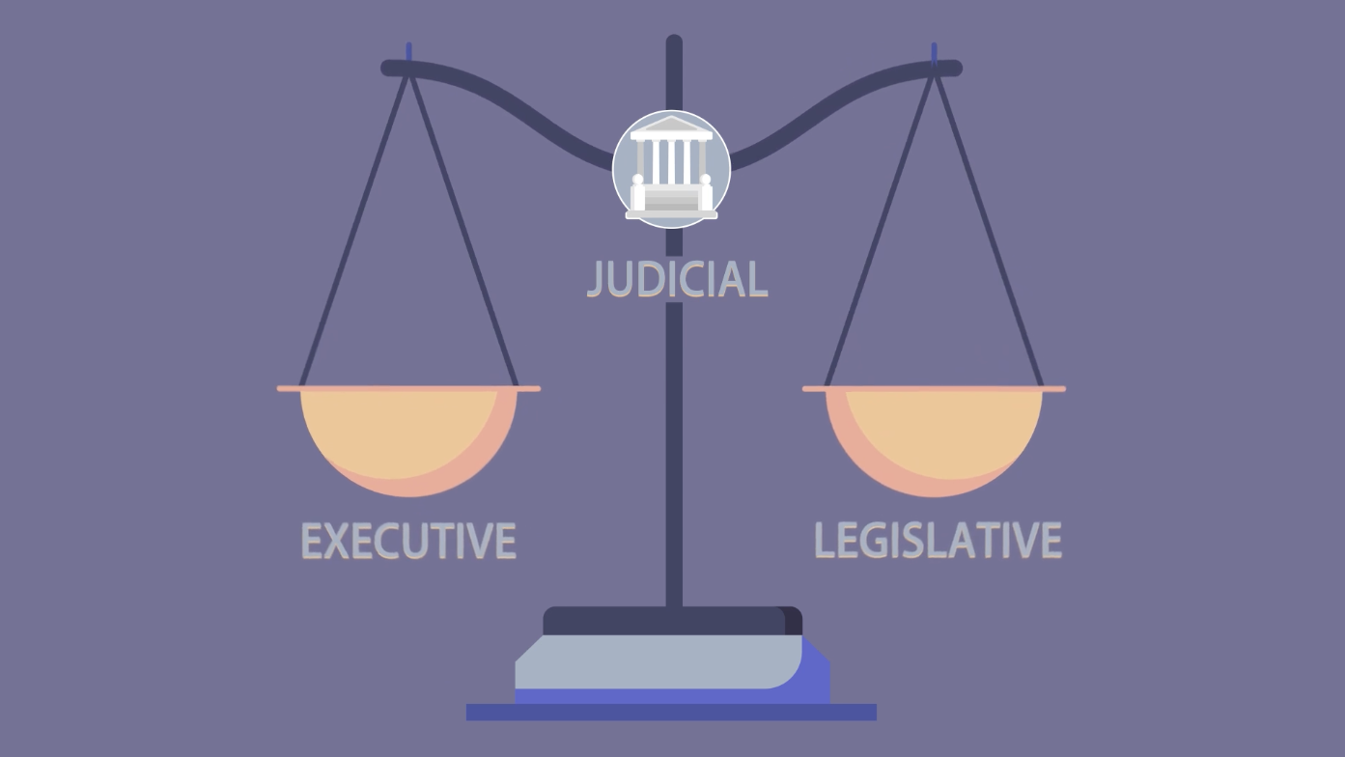
The Preamble (the introduction) says why the
Constitution was written.
The Constitution sets up three branches of government:
What’s in the Constitution
Legislative branch (makes the laws)
Executive branch (carries out the laws)
Judicial branch (explains the laws)

Slide 6
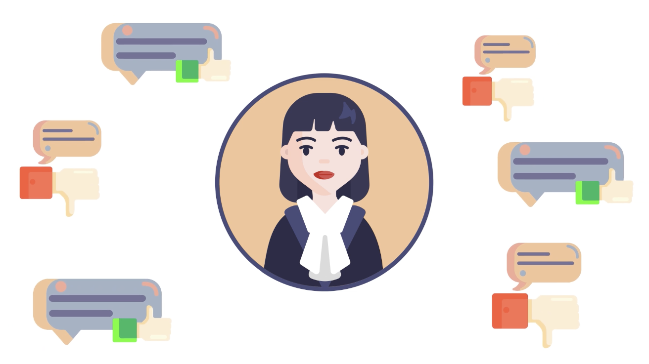
The Bill of Rights is the first 10 changes, called amendments, which protect important freedoms like speech and religion.
Important rights

Slide 7
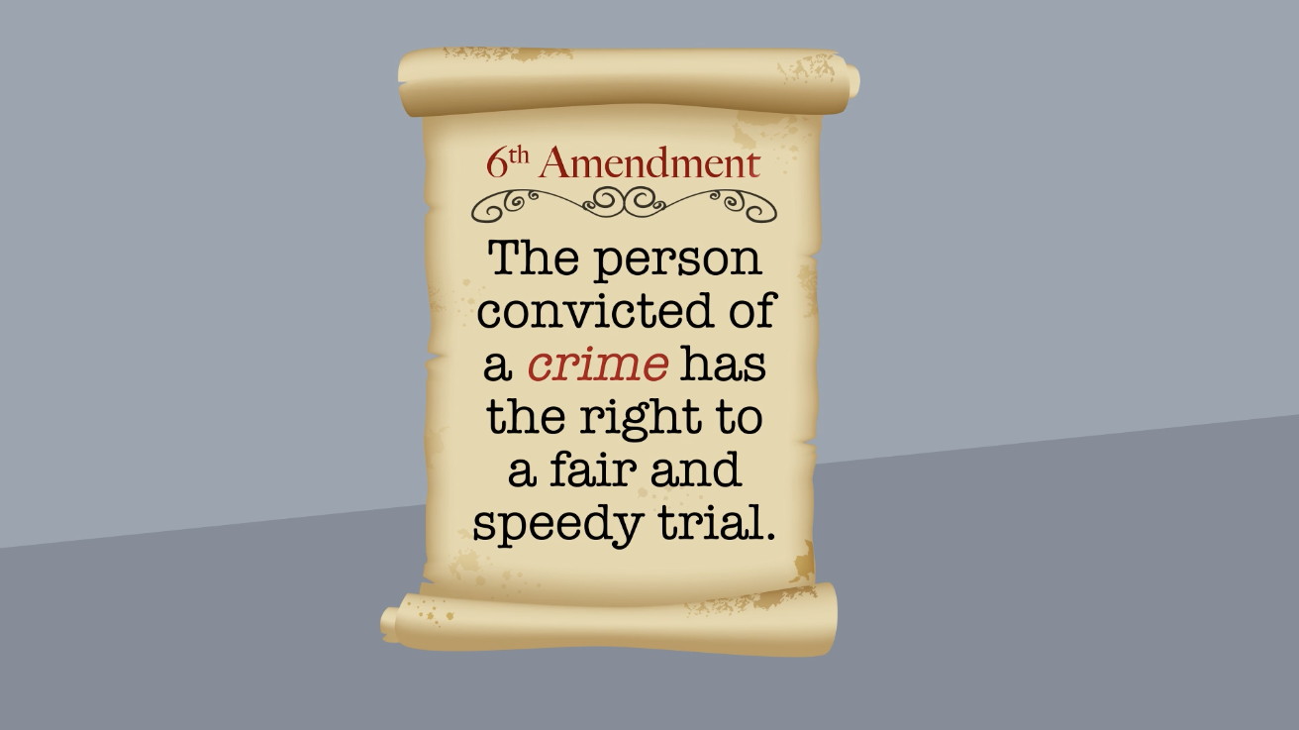
The Constitution can be changed if people agree—these changes are called amendments.
Changing the Constitution

Slide 8
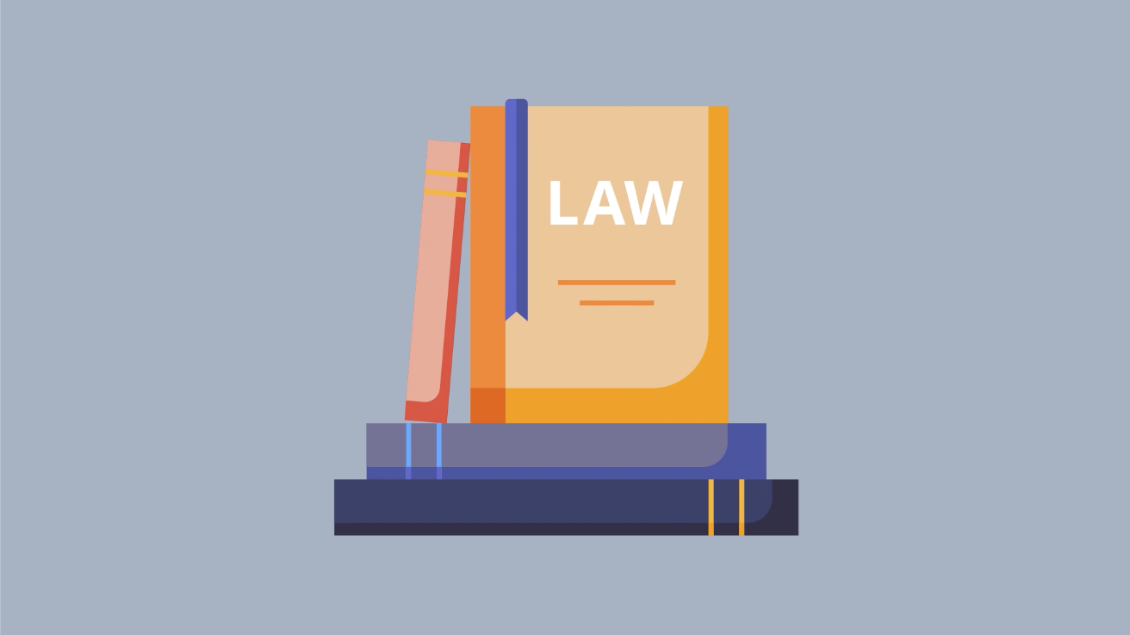
It is the highest law in the land.
Helps keep our country strong and fair for everyone.
wHy is it important

Slide 9

For additional resources, check out the Pa Courts’ civics education toolkit at www.pacourts.us/civics-ed

