Slide 1
The Superior Court
of Pennsylvania

Slide 2
The Superior Court hears appeals from the Courts of Common Pleas in Pennsylvania’s 67 counties to determine if errors were made at the trial court level.
Virtually all criminal and most civil appeals come to the Superior Court –
one of the busiest and most productive appellate courts in the country.

Slide 3
Since 2018, The Court Has Disposed of ​
5,500-8,000 Cases Per Year.​

Slide 4

Supreme Court
Superior Court
Commonwealth Court
Courts of Common Pleas
Magisterial District Courts

Slide 5
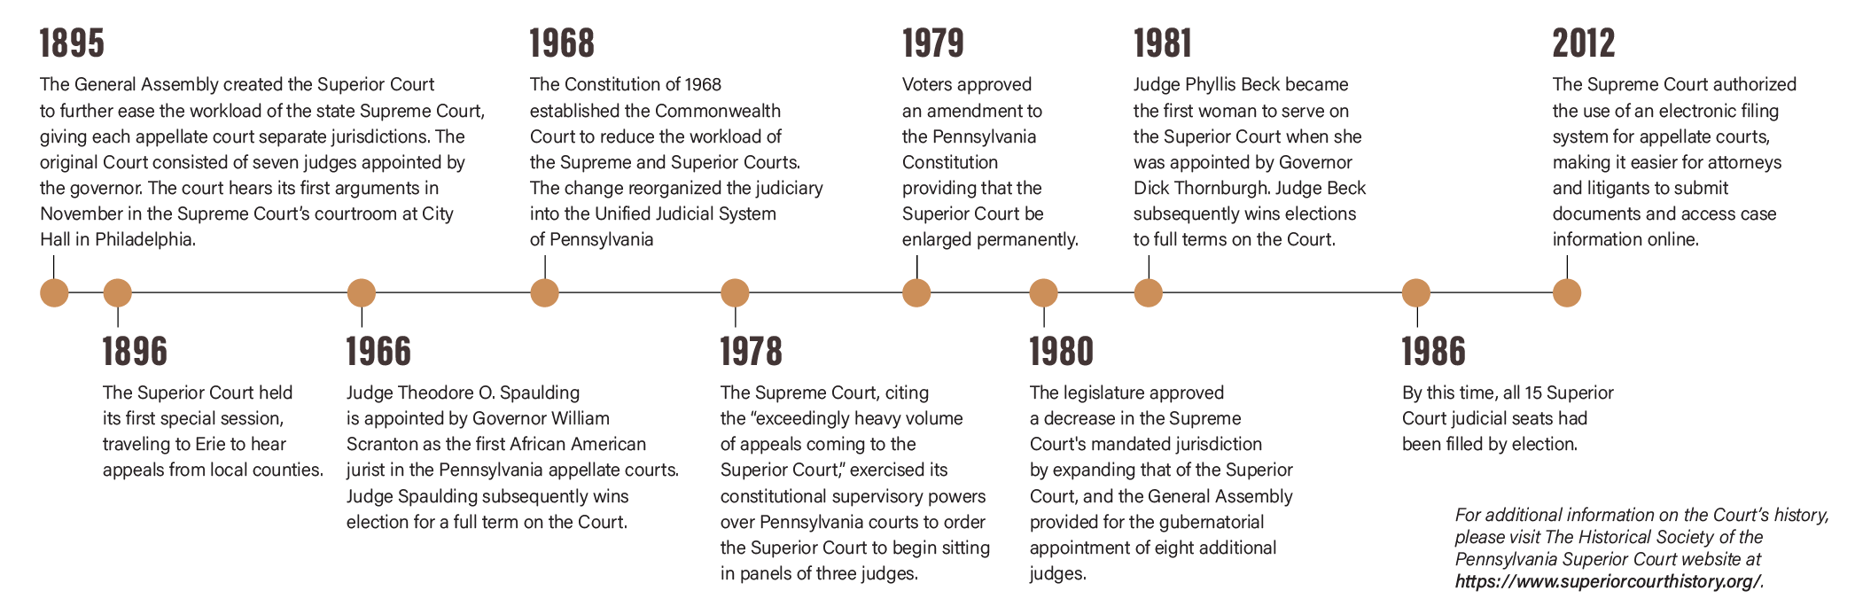
Timeline of the Court

Slide 6
About the Court
Established by the Pennsylvania General Assembly in 1895 to hear appeals from the Courts of Common Pleas
Since that time, the scope of the Court has evolved and today it decides appeals touching almost every aspect of life and commerce in the state including:
  family law matters such as child custody, visitation, adoption, divorce and support
  criminal cases
  matters concerning wills and estates, property disputes and those involving damages for breach of contract or personal injury

Slide 7
=
How Does the Court Operate?
The Court’s current judges exercise statewide jurisdiction and maintain chambers in locations of their choice.
The judges sit primarily in three-judge panels and decide cases that are either argued orally or submitted on briefs alone.
Several times a year, the commissioned Judges sit en banc, which means that nine judges decide appeals that have been deemed to carry statewide importance, either as a result of a litigant’s application or upon the Court’s own determination.
Appeals Docket – 92%
Wiretap Docket – 1.2%
Miscellaneous Docket – 6.8%

Slide 8
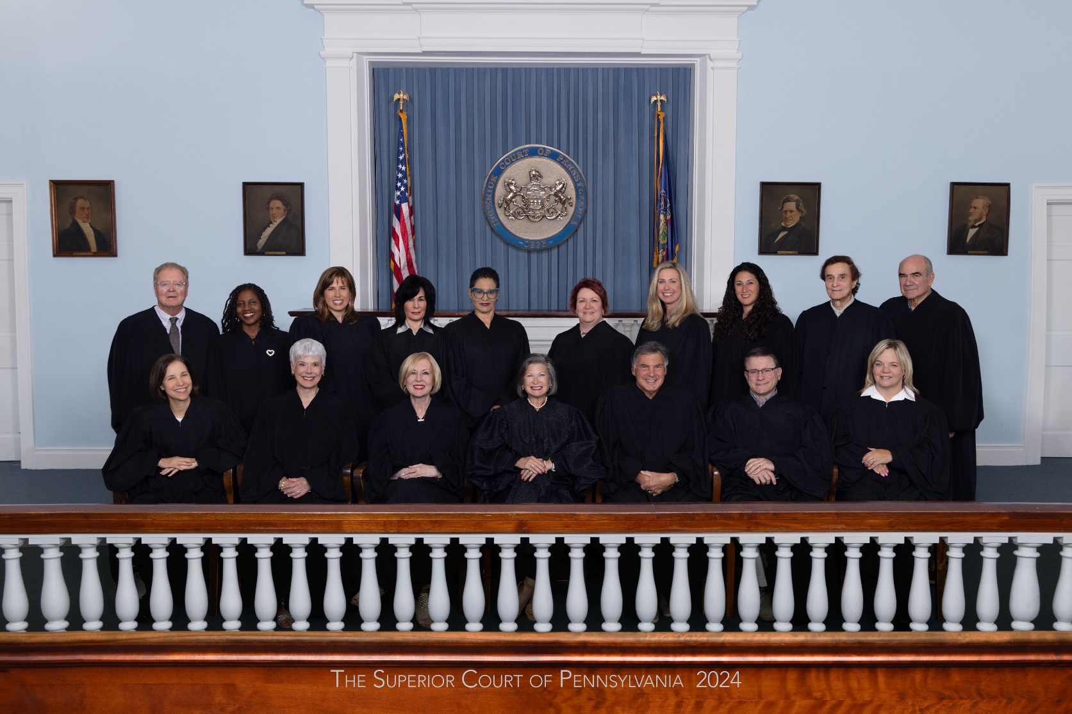
Who is the Superior Court?

Slide 9
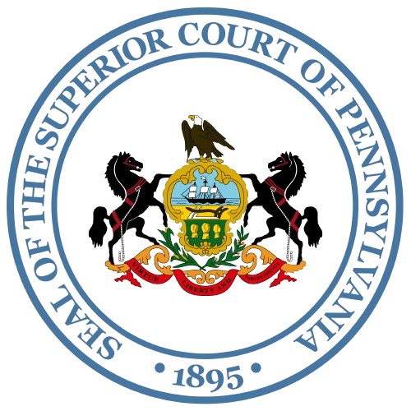
Often the Final Arbiter of Legal Disputes
The Court is Made up of 15 Judges
  Originally was only seven judges but due to exceedingly heavy volume of appeals coming to the Court, the number of judges was increased via a constitutional amendment.
  The president judge oversees court operations and is chosen by election of the Court to serve a five-year term.
  The Court generally sits in three judge panels or en banc with nine judges.
  It is the last Court to hear approximately 98% of the cases that come before it.
  All cases decided by the Superior Court can be reviewed by the Supreme Court, but are only heard in the Supreme Court’s discretion

Slide 10
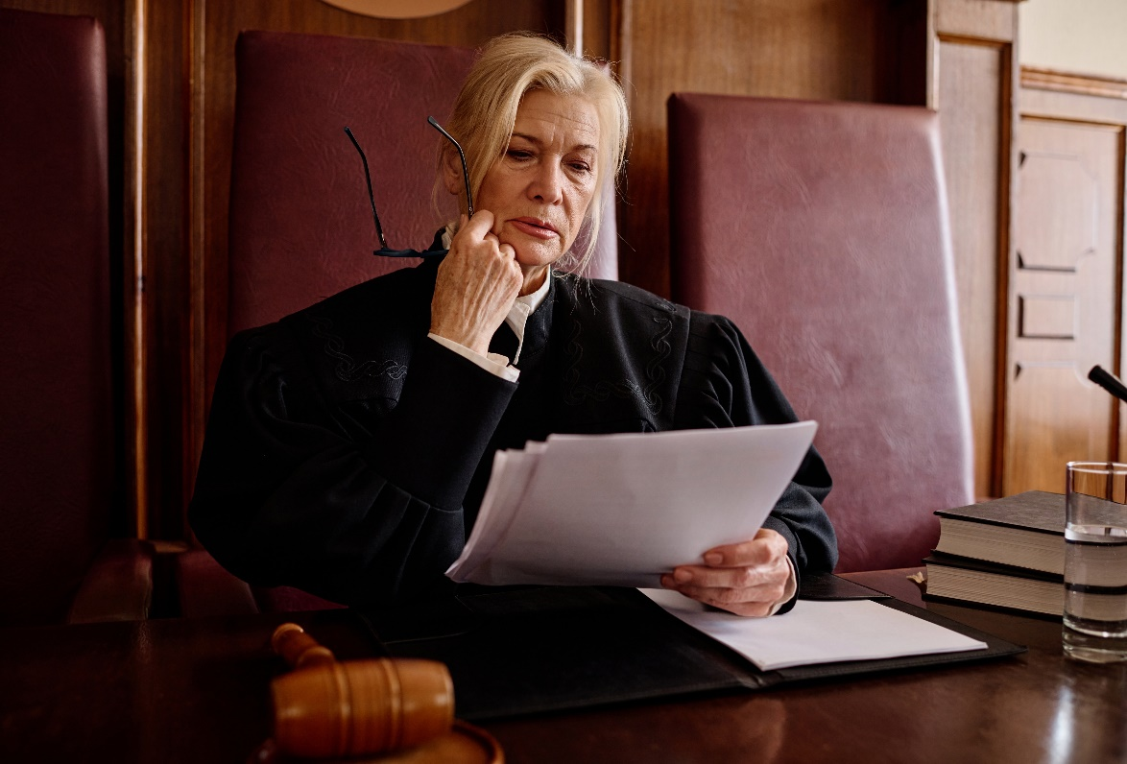
Senior Judges
Senior judges assist the Court as needed and can serve until age 78.
Retired judges who serve as senior judges help ease court backlogs by targeting areas that specifically need help, whether it be from an increased caseload, an unexpected judicial vacancy or a case in which a county needs an outside judge because judges in a county have a conflict of interest.
To be eligible for senior certification, a jurist must:
  have served as a judge, whether or not continuously or on the same court, by election or appointment for an aggregate period equaling 10 years
  be at least 65 years of age

Slide 11
How Are Judges Elected?
The initial election is a partisan election, requiring judges to run as a member of a political party. Once a person is elected as a judge, however, they are precluded from participating in any partisan political activity.
As soon as a person announces their candidacy for judge, they are bound by Pennsylvania’s ethical rules that govern all Pennsylvania judges.
After serving a 10-year term, judges run for retention unopposed. Their names appear on the ballot in the fall election, and they are not affiliated with any political party.
    Voters vote “yes” to retain the judge or “no” to remove the judge.
    If a jurist is not retained, the governor has the authority to appoint an interim judge with two-thirds Senate approval. The position is filled permanently in the next judicial election.
    Retention votes only occur in the appellate, Courts of Common Pleas and Philadelphia Municipal Court. They do not occur in Magisterial District Courts.
  Since 1989, judicial elections always occur in odd-numbered years.
Judges are elected,
not appointed, and then stand
for a retention vote.
When a vacancy occurs, the governor may fill the vacancy by appointment, with Senate confirmation. The appointee serves for a term ending the first Monday of January following the next municipal election.

Slide 12
Qualifications
Pa. resident and U.S. citizen
Ages 21-75
State bar member (except MDJs who must be members of the bar or pass a qualifying exam)
Judges serve 10-year terms up to age 75.

Slide 13

Where do They
Hold Argument?
Philadelphia
Harrisburg
Pittsburgh
The Court frequently holds special sessions in locations across the commonwealth.

Slide 14
How Does the Court Impact Me?
The Pennsylvania Superior Court’s rulings can significantly impact people’s lives in several ways:
Legal Precedents: The Court's decisions set legal precedents that can affect future cases. These precedents can influence how laws are interpreted and applied to all Pennsylvanians, not just the parties that come before the Court, impacting a wide range of legal matters, from criminal justice to family law.
Case Outcomes: If a case is appealed to the Superior Court, its decision can overturn or uphold a lower court's ruling. This can affect the outcome of individual cases, including civil disputes, criminal convictions and family law matters.
Consistency and Fairness: The Superior Court helps ensure that laws are applied consistently across different cases and counties. This contributes to a fairer legal system, as similar cases are handled in similar ways.
Legal Guidance: For attorneys and legal professionals, the Court's opinions provide guidance on how to navigate the legal system and advise their clients.

