Slide 1
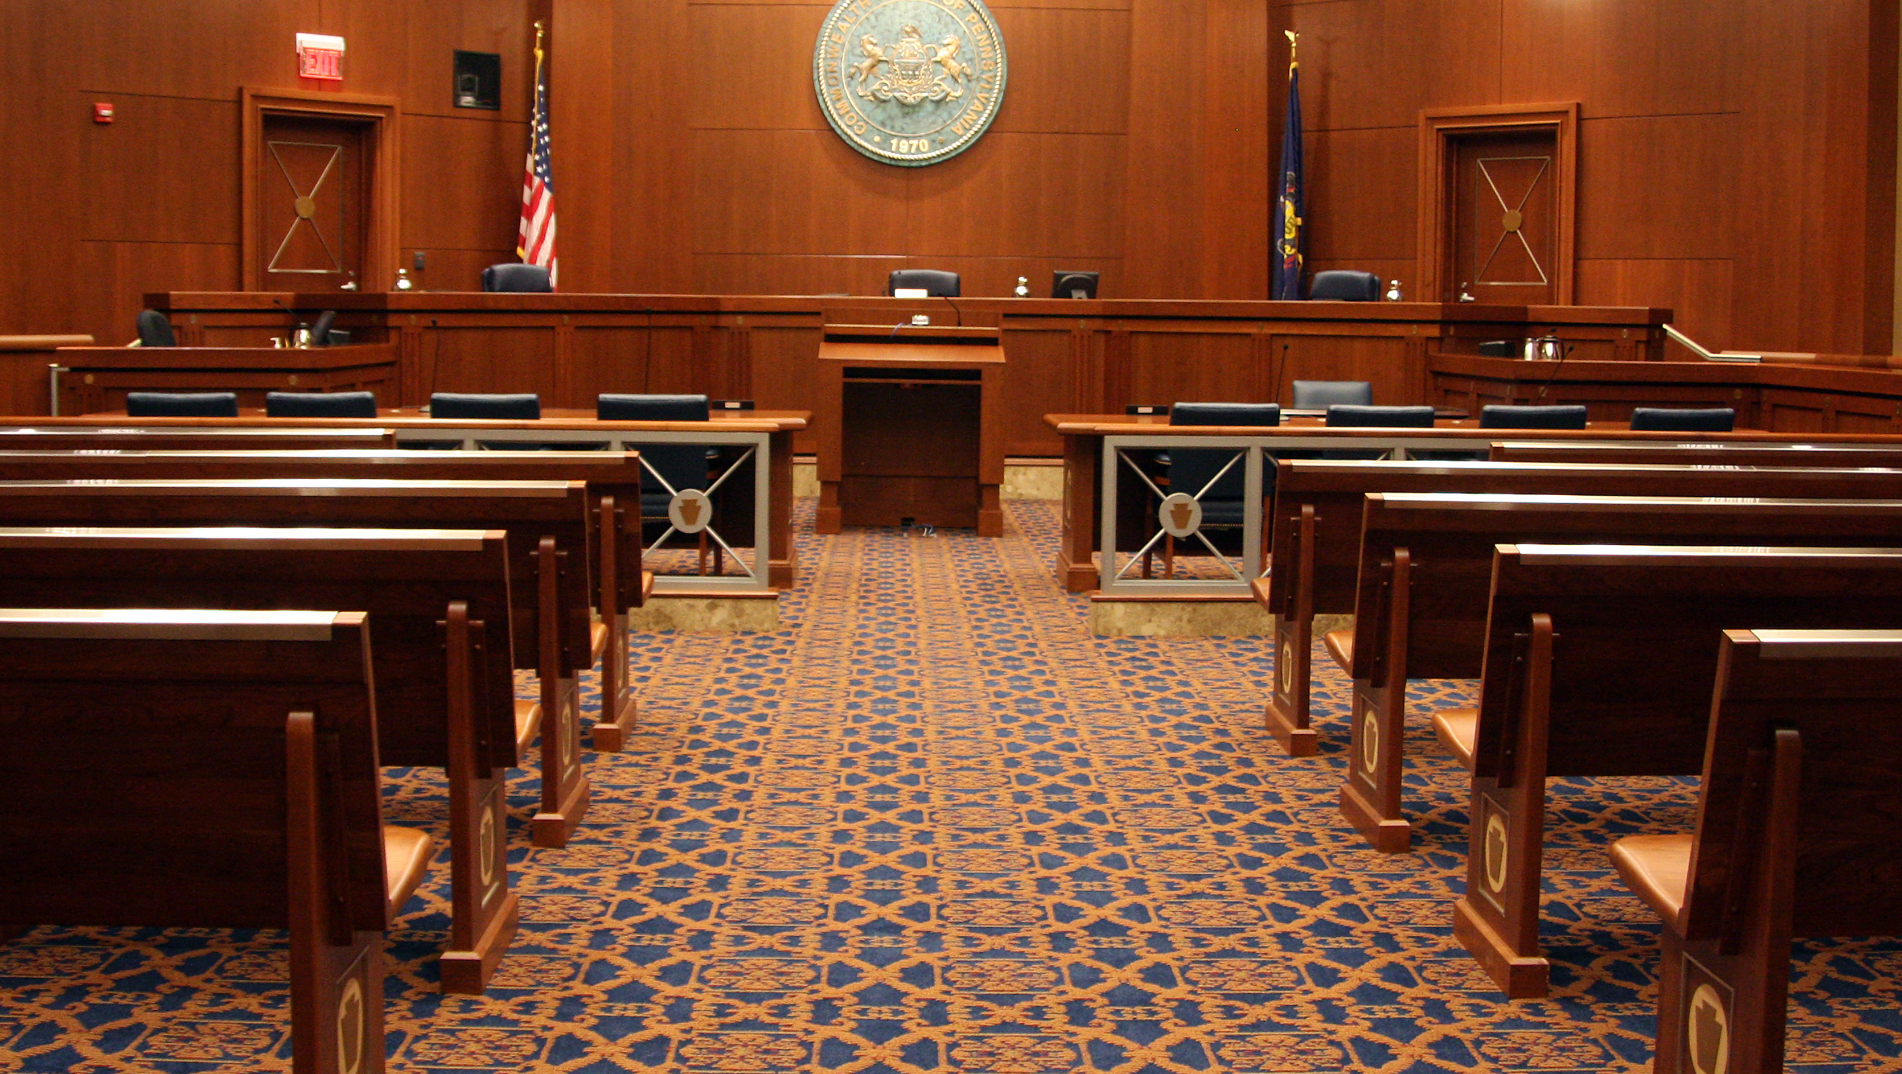
The Commonwealth Court
of Pennsylvania

Slide 2
The Commonwealth Court issues decisions that affect the relationship that Pennsylvania’s citizens have with their local and state government.
The Commonwealth Court is one of Pennsylvania’s two statewide intermediate appellate courts.

Slide 3
The Commonwealth Court issues over ​
1,000 Opinions Per Year.​

Slide 4

Supreme Court
Superior Court
Commonwealth Court
Courts of Common Pleas
Magisterial District Courts

Slide 5
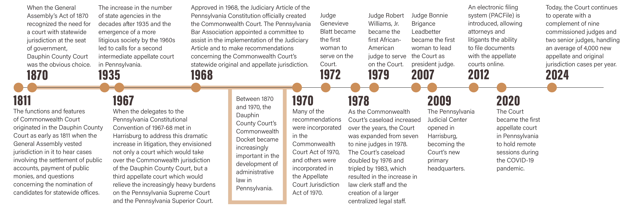
Timeline of the Court

Slide 6
About the Court
Established in 1968, the Commonwealth Court is unique.
It is the only intermediate appellate court in the nation that specializes in governmental and administrative law matters.
The Court is also unique because it can act as an appellate court or as a trial court.
  It hears appeals from decisions of both state administrative agencies and the courts of common pleas (county trial courts).
  It also acts as a trial court in certain civil cases brought by or against the Commonwealth government.

Slide 7
=
How Does the Court Operate?
The Court’s current judges exercise statewide jurisdiction and maintain Chambers in locations of their choice.
The judges sit primarily in three-judge panels and decide cases that are either argued orally or submitted on briefs alone.
Several times a year, the commissioned Judges sit en banc, which means that a majority of the judges decide appeals that have been deemed to carry statewide importance, either as a result of a litigant’s application or upon the Court’s own determination.

Slide 8
Examples of the types of cases that come before the Court
Claims for unemployment compensation benefits
Claims for workers’ compensation benefits
Requests for information under the Right-to-Know Law
Challenges to personal, business and property taxes
Qualifications to be a candidate for public office and the legality of Pennsylvania’s elections
Challenges to the suspension or revocation of a license to drive
Constitutionality of statutes and agency regulations

Slide 9
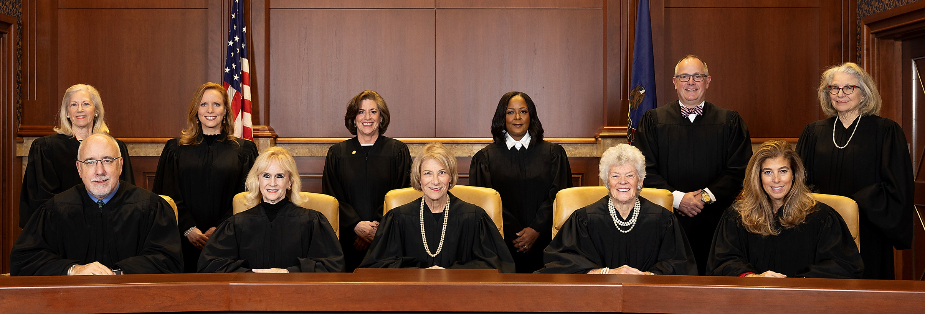
Who is the Commonwealth Court?

Slide 10

The Role of the Court
The Court is Made up of 9 Judges
The Commonwealth Court is primarily responsible for resolving cases that involve state and local governments and regulatory agencies.
  The Court handles many high-profile matters of great public importance, including disputes involving our elections and voting rights, funding of our public schools, and amendments to our Constitution.
  When the Court hears challenges to legislation or administrative regulations, it acts as an important check on legislative and executive power.

Slide 11

Senior Judges
Senior judges assist the Court as needed and can serve until age 78.
Retired judges who serve as senior judges help ease court backlogs by targeting areas that specifically need help, whether it be from an increased caseload, an unexpected judicial vacancy or when a common pleas court needs an outside judge because judges in the county have a conflict of interest.
To be eligible for senior certification, a jurist must:
  have served as a judge, whether or not continuously or on the same court, by election or appointment for an aggregate period equaling 10 years
  be at least 65 years of age

Slide 12
How Are Judges Elected?
The initial election is a partisan election, requiring judges to run as a member of a political party. Once a person is elected as a judge, however, they are precluded from participating in any partisan political activity.
As soon as a person announces their candidacy for judge, they are bound by Pennsylvania’s ethical rules that govern all Pennsylvania judges.
After serving a 10-year term, judges run for retention unopposed. Their names appear on the ballot in the fall election, and they are not affiliated with any political party.
    Voters vote “yes” to retain the judge or “no” to remove the judge.
    If a jurist is not retained, the governor has the authority to appoint an interim judge with two-thirds Senate approval. The position is filled permanently in the next judicial election.
    Retention votes only occur in the appellate, Courts of Common Pleas and Philadelphia Municipal Court. They do not occur in Magisterial District Courts.
  Since 1989, judicial elections always occur in odd-numbered years.
Judges are elected,
not appointed, and then stand
for a retention vote.
When a vacancy occurs, the governor may fill the vacancy by appointment, with Senate confirmation. The appointee serves for a term ending the first Monday of January following the next municipal election.

Slide 13
Qualifications
Pa. resident and U.S. citizen
Ages 21-75
State bar member (except MDJs who must be members of the bar or pass a qualifying exam)
Judges serve 10-year terms up to age 75.

Slide 14
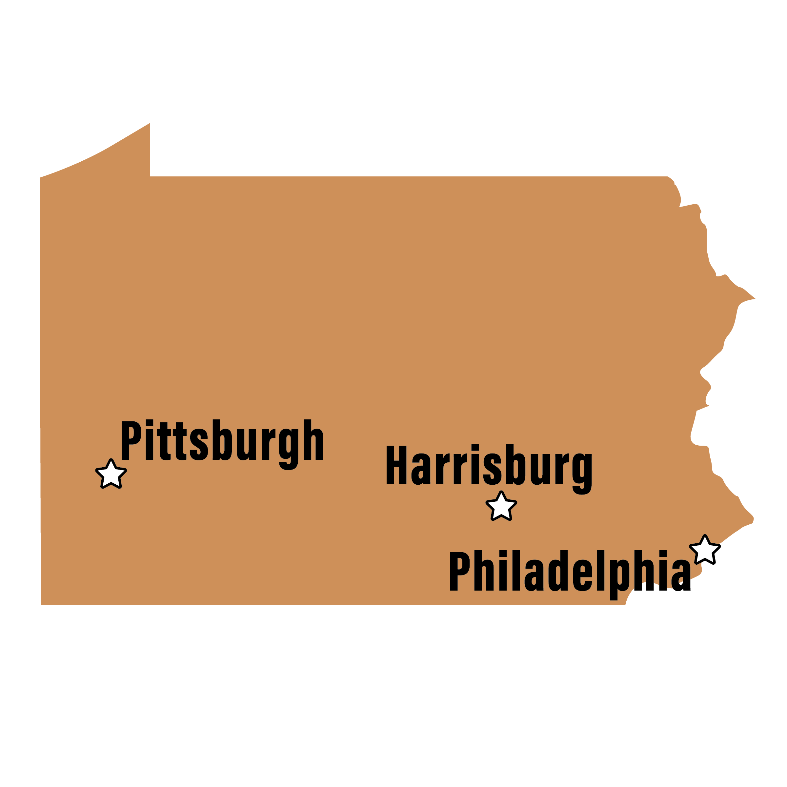
Where do They
Hold Argument?
Philadelphia
Harrisburg
Pittsburgh
The Court frequently holds special sessions in locations across the Commonwealth.

Slide 15
How Does the Court Impact Me?
Pennsylvania's Commonwealth Court plays a significant role in shaping the legal landscape for its citizens, as it serves as a specialized appellate court with jurisdiction over cases involving the state government, administrative agencies, and certain other matters of public interest. The Court:
Reviews agency decisions, ensuring fairness in regulations and public services.
Protects constitutional rights by hearing challenges to state laws and actions.
Oversees elections, ensuring fair voting and election practices.
Handles environmental and land use disputes, protecting public resources.
Reviews education funding, impacting public school quality.
Resolves labor disputes for public employees.
Allows appeals of local government decisions, such as zoning or ordinances.
The Commonwealth Court impacts Pennsylvania's citizens by providing a critical check on government actions, ensuring that state laws and regulations are applied fairly and that individuals' rights are protected. Whether it's a matter of public policy, environmental protection, education, or personal rights, the Court plays a key role in determining how laws affect the daily lives of Pennsylvanians.

