Slide 1
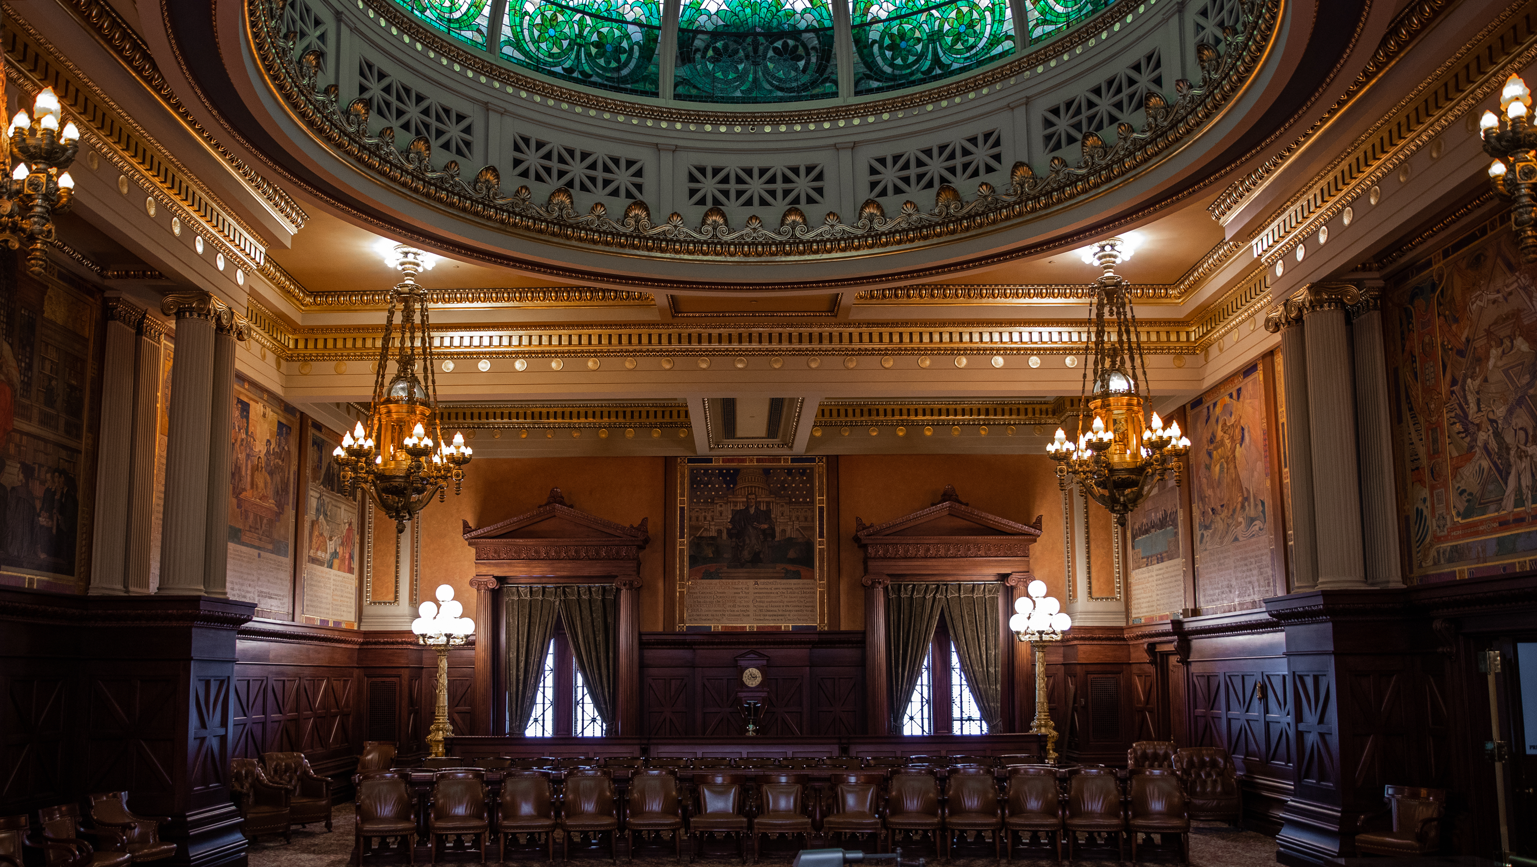
The Supreme Court
of Pennsylvania

Slide 2
The Supreme Court is the highest court in the Commonwealth.
Dating back to 1684, it’s the oldest appellate court in North America.

Slide 3
The Court receives and considers over​
2,000 Cases Per Year.​

Slide 4

Supreme Court
Superior Court
Commonwealth Court
Courts of Common Pleas
Magisterial District Courts

Slide 5
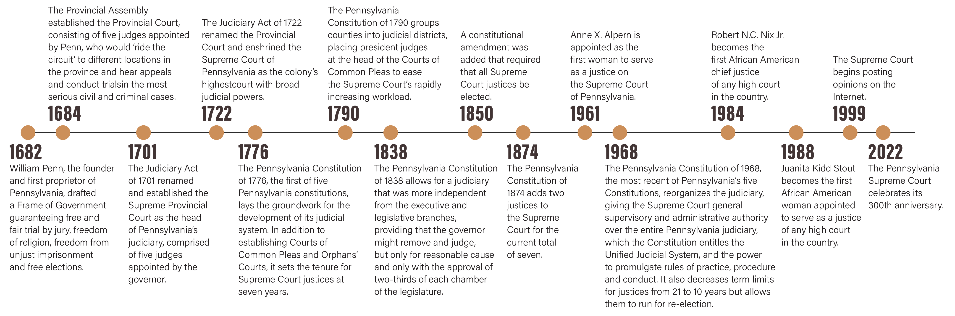
Timeline of the Court

Slide 6
About the Court
The Court is made up of 7 Justices
  Justices serve 10-year terms, up to age 75
  The justice with the longest continuous service on the Court automatically becomes chief justice.
  The Court generally sits in three judge panels or en banc with nine judges.
  The Court supervises the entire Pennsylvania Unified Judicial System, makes procedural rules for administration of justice in the courts, and regulates the practice of law – including admission to the bar and attorney discipline.

Slide 7
=
How Does the Court Operate?
The Court’s current judges exercise statewide jurisdiction and maintain chambers in locations of their choice.
The judges sit primarily in three-judge panels and decide cases that are either argued orally or submitted on briefs alone.
Several times a year, the commissioned Judges sit en banc, which means that nine judges decide appeals that have been deemed to carry statewide importance, either as a result of a litigant’s application or upon the Court’s own determination.
The Court…
primarily hears appeals from Commonwealth and Superior Courts, but also hears direct appeals such as death penalty cases.
can consider any case pending in a lower court of “immediate public importance”
at its own discretion, will grant an appeal upon approval of three justices.

Slide 8
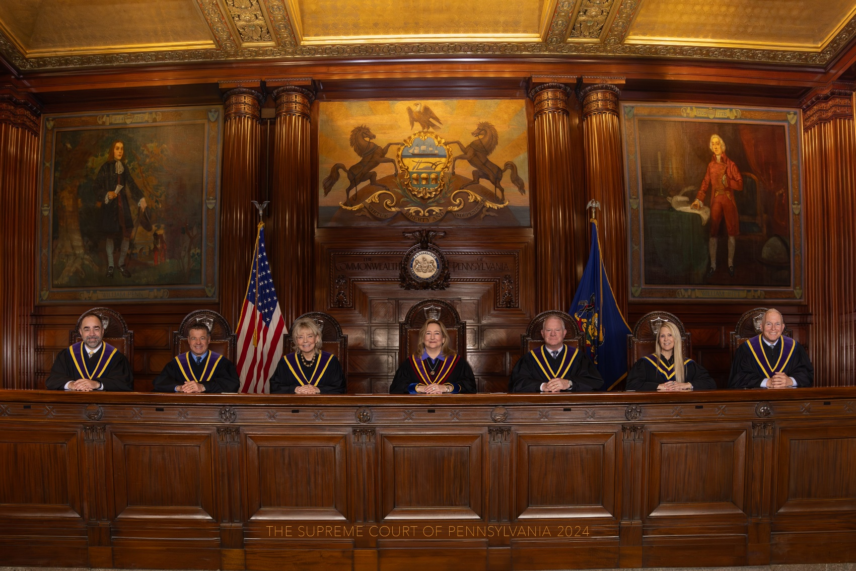
Who is the Supreme Court?

Slide 9
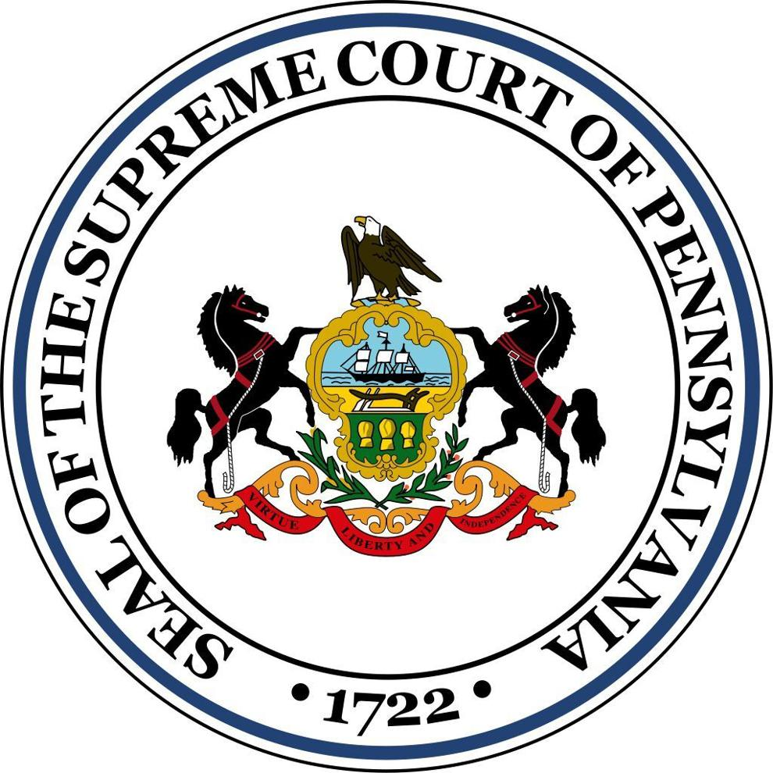
What happens once a case is selected for review
  1. Parties make arguments: Justices review briefs and usually hear oral arguments.
  2. Justices write opinions:
      Majority opinion – shared by more than half of the Court and becomes the Court’s decision
      Dissenting opinion – disagrees with the disposition of the case
      Concurring opinion – agrees with result but not necessarily the rationale
    3. Court issues decision: The Court hands down a decision within defined timelines after the oral argument (or submission of a case).

Slide 10
How Are Judges Elected?
The initial election is a partisan election, requiring judges to run as a member of a political party. Once a person is elected as a judge, however, they are precluded from participating in any partisan political activity.
As soon as a person announces their candidacy for judge, they are bound by Pennsylvania’s ethical rules that govern all Pennsylvania judges.
After serving a 10-year term, judges run for retention unopposed. Their names appear on the ballot in the fall election, and they are not affiliated with any political party.
    Voters vote “yes” to retain the judge or “no” to remove the judge.
    If a jurist is not retained, the governor has the authority to appoint an interim judge with two-thirds Senate approval. The position is filled permanently in the next judicial election.
    Retention votes only occur in the appellate, Courts of Common Pleas and Philadelphia Municipal Court. They do not occur in Magisterial District Courts.
  Since 1989, judicial elections always occur in odd-numbered years.
Judges are elected,
not appointed, and then stand
for a retention vote.
When a vacancy occurs, the governor may fill the vacancy by appointment, with Senate confirmation. The appointee serves for a term ending the first Monday of January following the next municipal election.

Slide 11
Qualifications
Pa. resident and U.S. citizen
Ages 21-75
State bar member (except MDJs who must be members of the bar or pass a qualifying exam)
Judges serve 10-year terms up to age 75.

Slide 12
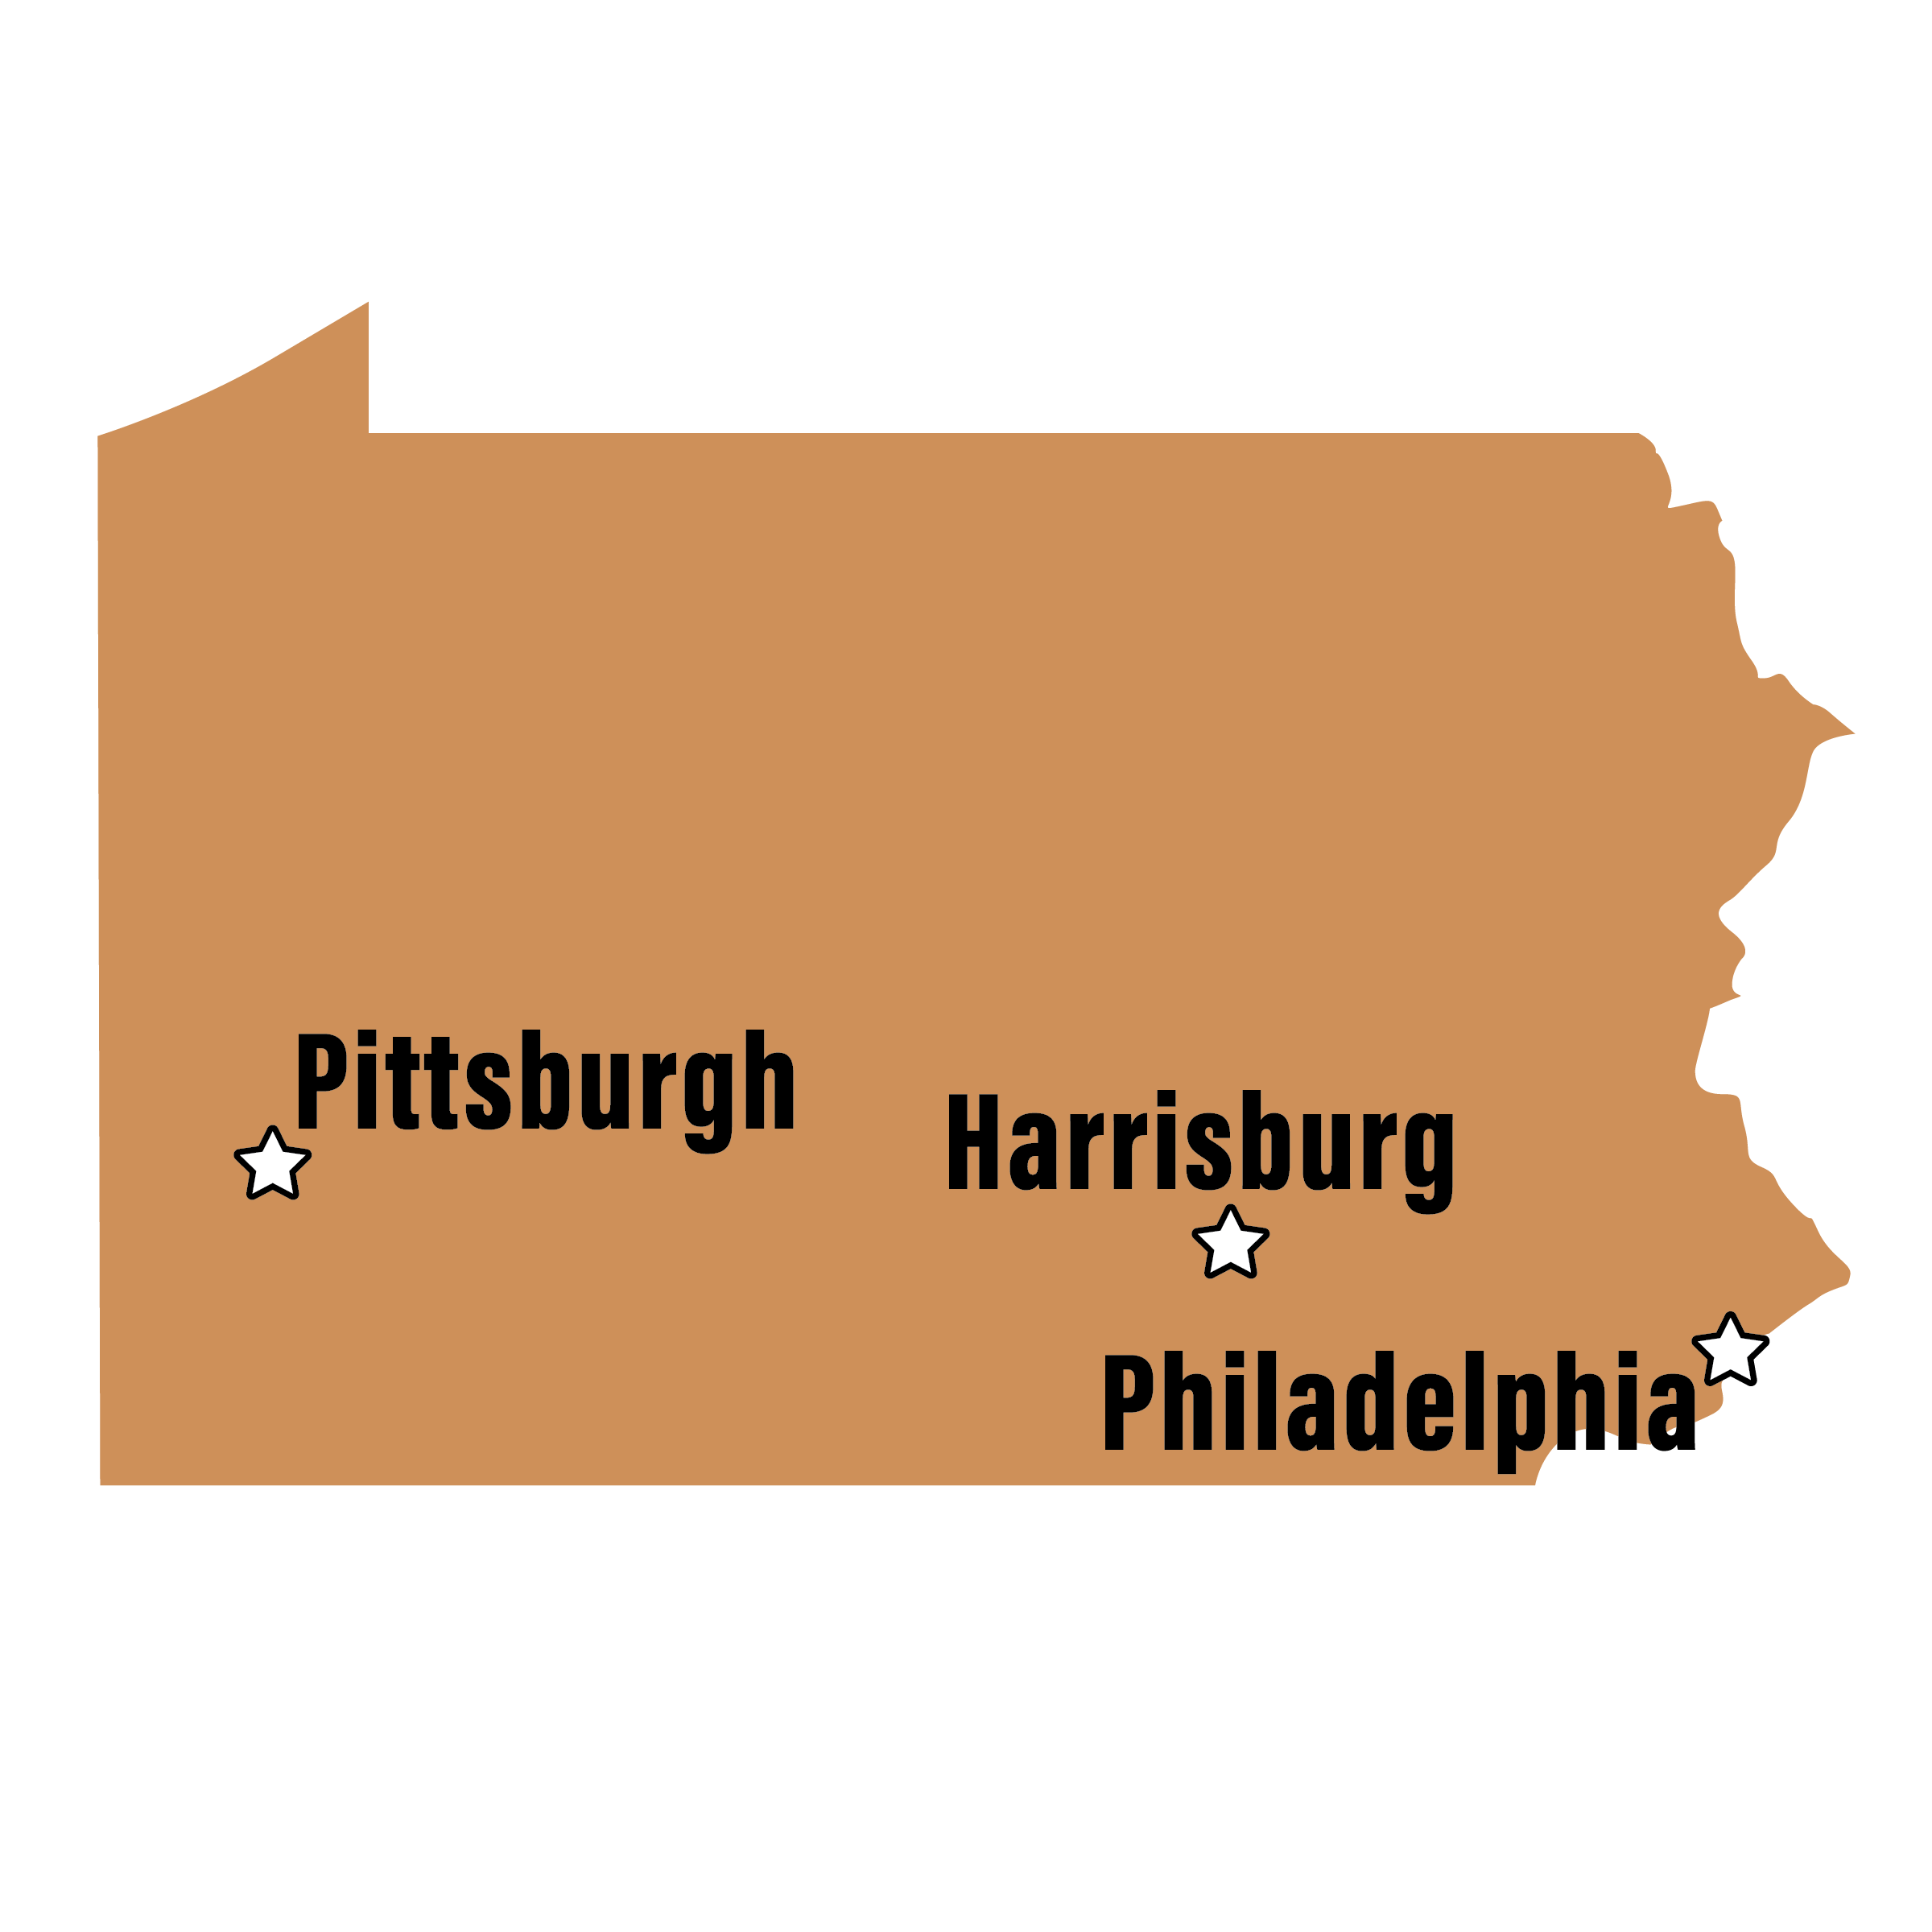
Where do They
Hold Argument?
Philadelphia
Harrisburg
Pittsburgh
The Court frequently holds special sessions in locations across the commonwealth.

Slide 13
How Does the Court Impact Me?
The Pennsylvania Supreme Court impacts the average citizen in several important ways:
Interpreting State Laws and Constitution: The Court is the final authority on interpreting Pennsylvania's laws and constitution. Its rulings can directly affect everyday life by determining how laws are applied in areas like criminal justice, civil rights and government regulation.
Overturning Lower Court Decisions: When individuals appeal court cases, the state Supreme Court can decide whether to uphold or reverse lower court rulings. This can impact the outcome of cases involving things like property disputes, family law or personal injury claims.
Influencing Policy and Legal Precedents: The decisions made by the Court set legal precedents that guide future cases. These rulings can shape public policy and influence areas such as education, healthcare, labor rights, and environmental protections.
Election Law: The Court plays a significant role in interpreting election law, including redistricting decisions and challenges to voting laws, which can affect how elections are conducted and who holds political power.
Overall, the Pennsylvania Supreme Court has a profound influence on citizens’ legal rights, social policies and daily lives, as its rulings can shape the laws that govern them.

