Slide 1
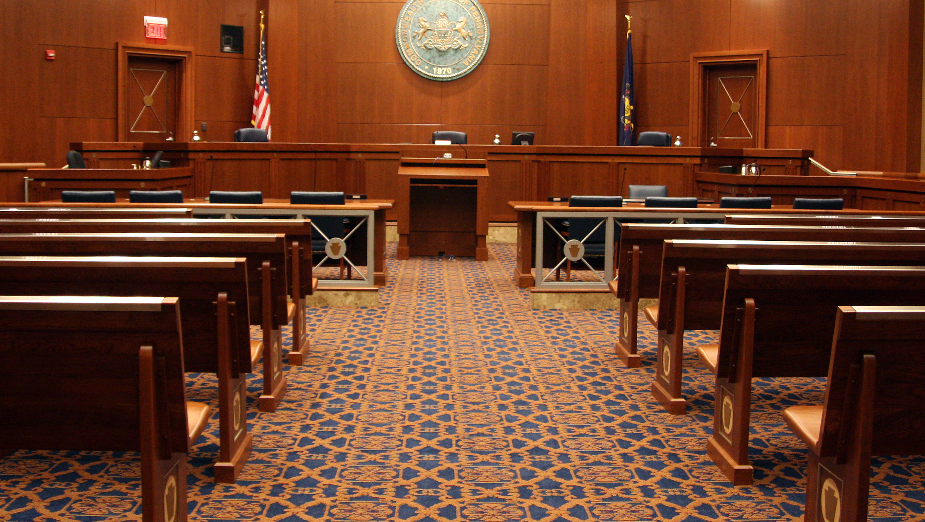
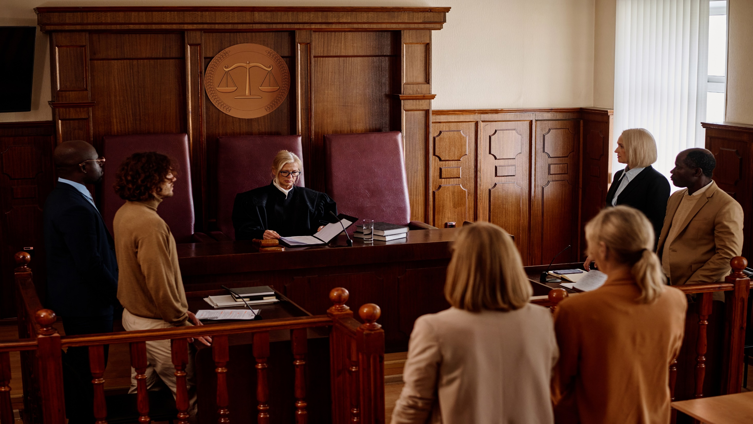
Understanding Pennsylvania’s
Magisterial District Courts

Slide 2
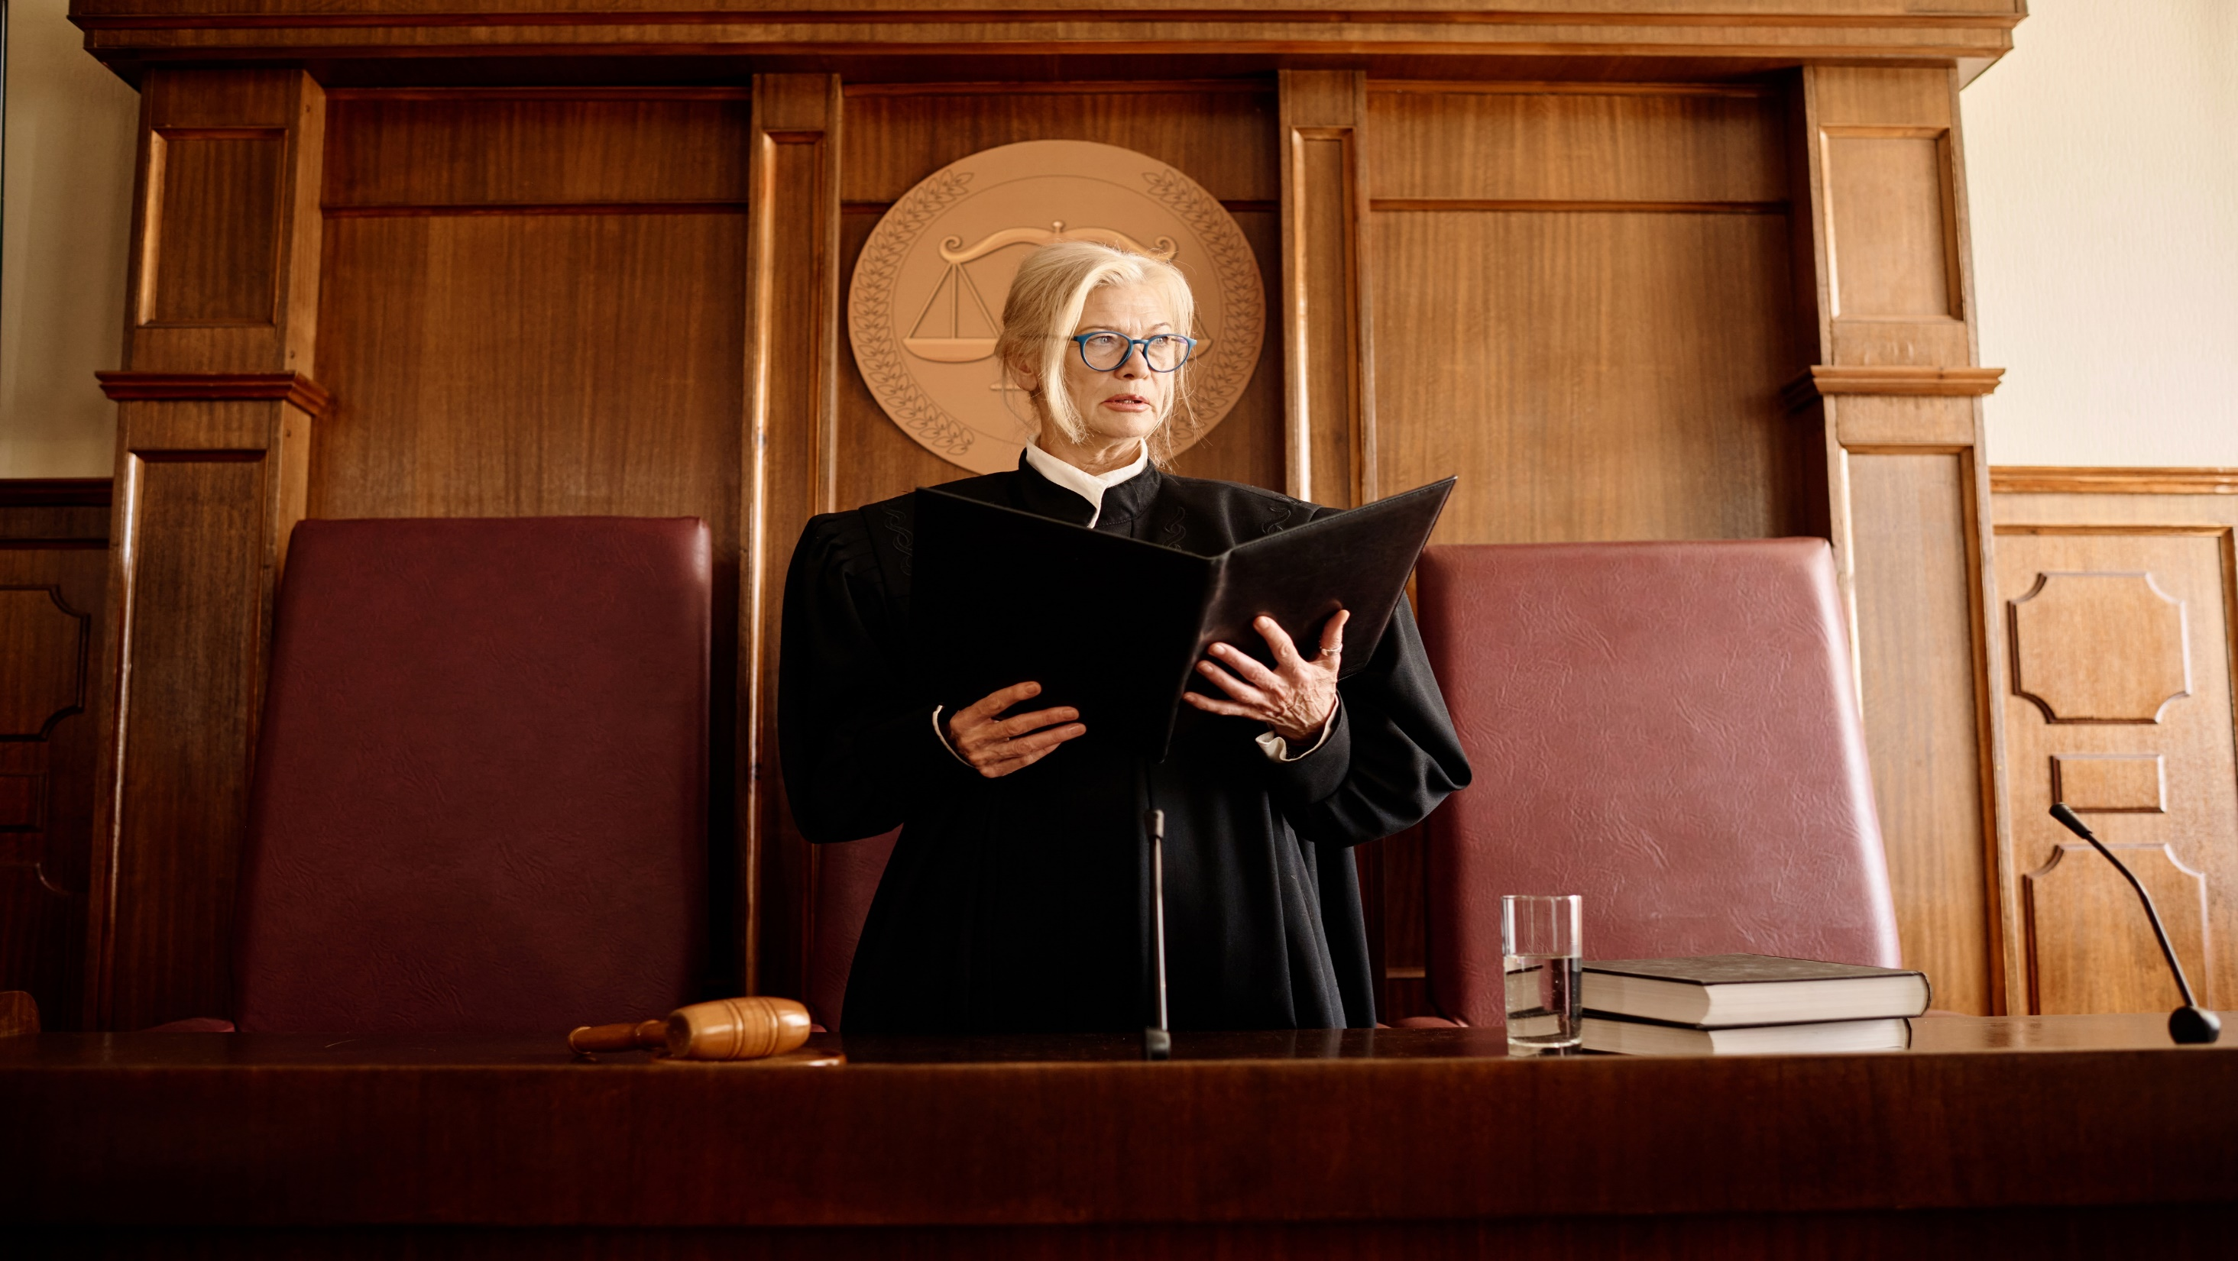
The magisterial district courts are where most people have their first experience with the judicial system. Magisterial District Judges (MDJs) handle civil cases with claim amounts up to $12,000, summary matters and have initial jurisdiction over all criminal cases.

Slide 3
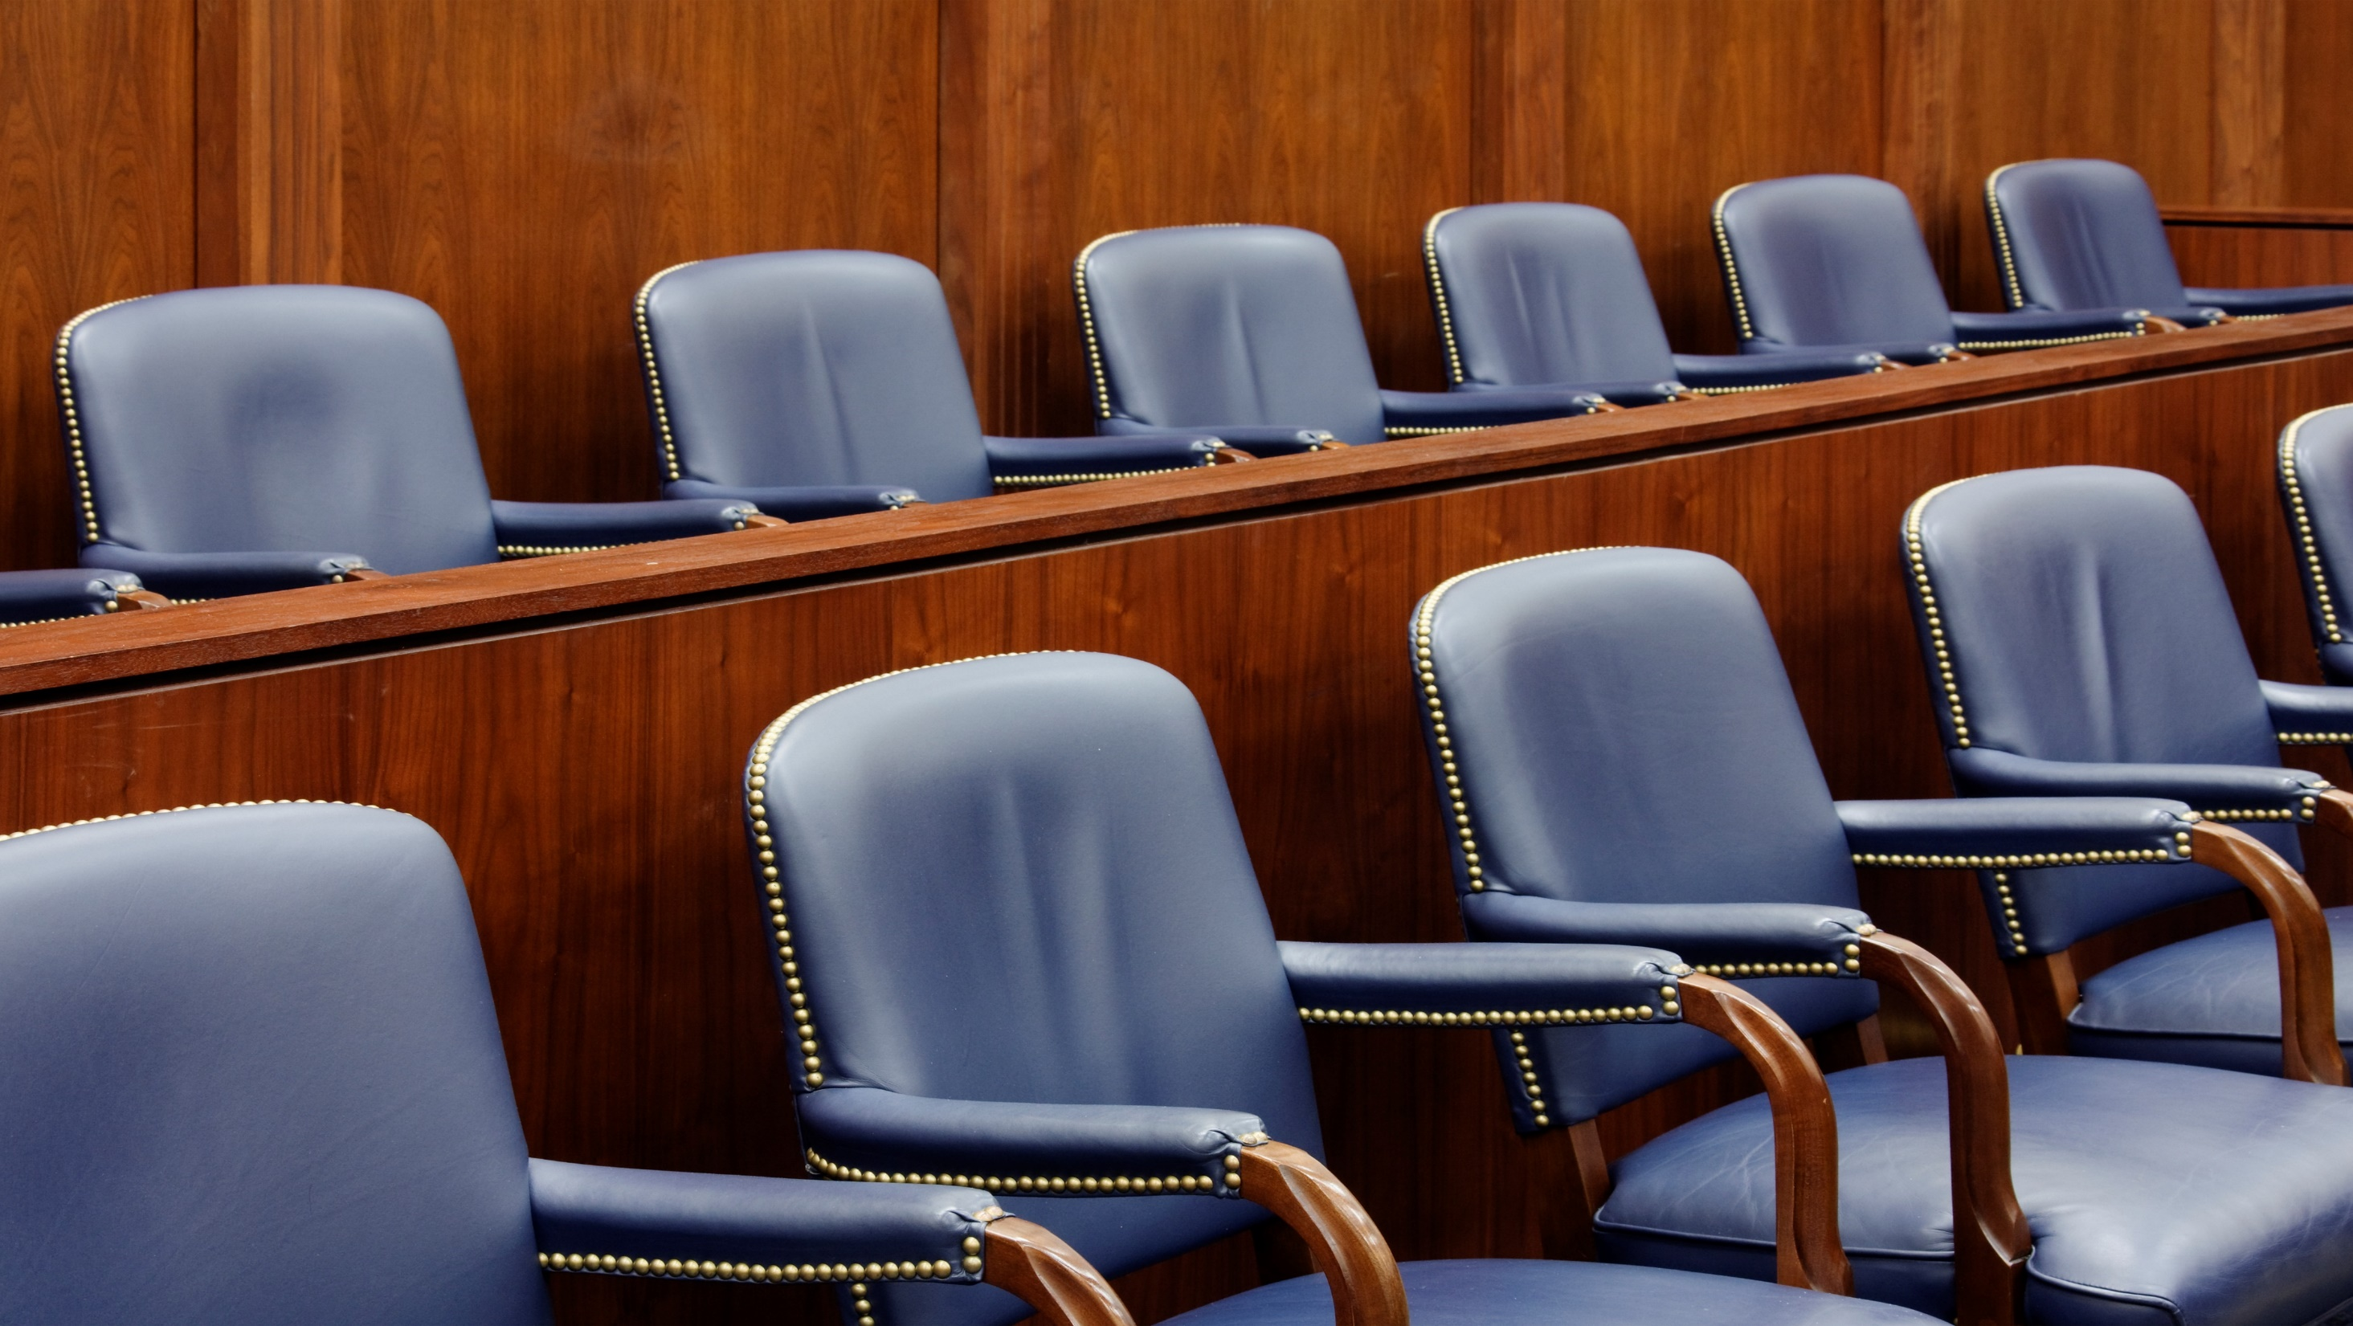
In Pennsylvania, there are more than 500 MDJs.
These courts handle over 2 million cases per year.

Slide 4

Supreme Court
Superior Court
Commonwealth Court
Courts of Common Pleas
Magisterial District Courts and Municipal Courts

Slide 5
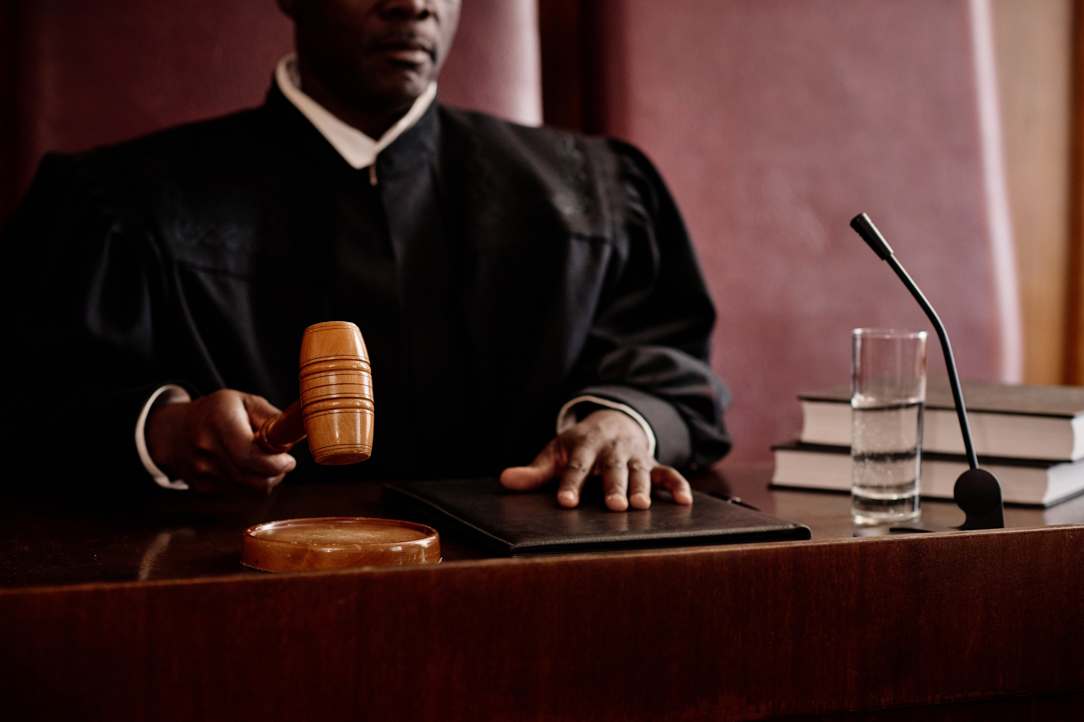
About the Courts
Minor courts, or special courts, are the first level of Pennsylvania's judiciary. These courts are presided over by MDJs and municipal court judges. MDJs do not have to be lawyers, but they are required to pass a qualifying exam. Each court has its own elected judge.
A president judge in Pennsylvania’s judicial districts is the administrative head of the court of common pleas, with leadership responsibility for their judicial district’s court of common pleas and magisterial district courts.

Slide 6

Types of cases
Traffic – Traffic-related cases make nearly 70 percent of MDJ cases.
Criminal – Under their jurisdiction, MDJs can:
  Issue search and arrest warrants
  Accept guilty pleas for certain offenses
  Conduct preliminary hearings
  Impose sentences for certain misdemeanors and summary offenses
Civil – Examples include landlord/tenant disputes, damage to property, breach of contract, etc.
Non-traffic – Examples include minor criminal offenses such as disorderly conduct or underage drinking.

Slide 7
Other MDJ Duties
May perform marriage ceremonies
Fix and set bail
Issue emergency Protection-from-Abuse Orders (PFAs)

Slide 8
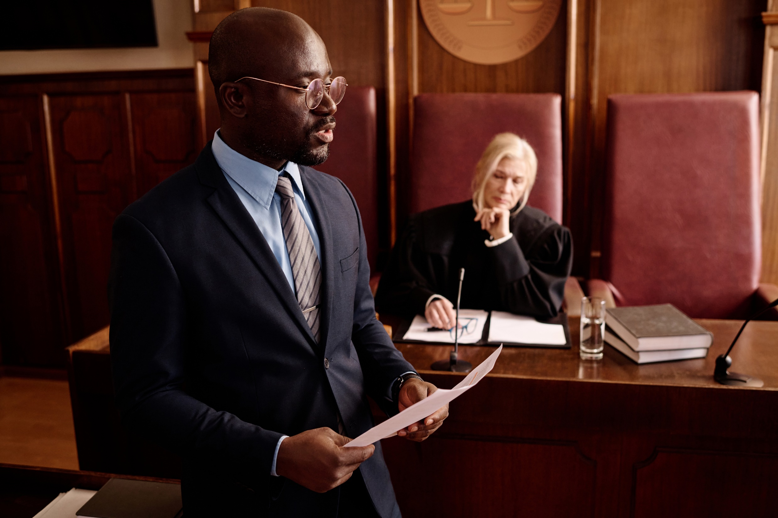

=
How Do the Courts Operate?
Criminal Case Process
Offense allegedly committed
Law enforcement response and investigation
Subject arrested Charges filed
(subject summoned to preliminary hearing without arrest)
Handled informally Subject booked Released without charge
and charges filed
Preliminary arraignment – initial appearance
(charges filed before MDJ, bail is set, preliminary hearing scheduled)
Bind over to Court of Common Pleas Charges are dropped or dismissed
(released on bail, diversion referral, or detained)
Notes:
Most criminal cases start with law enforcement conducting some form of an investigation. If as a result of the investigation a defendant is arrested and charged, the case can proceed a few different ways. When a defendant is arrested by law enforcement, the arresting officer can ask the court to arraign the defendant without unnecessary delay or the officer can file the charges with the court asking the court to issue a summons and direct the defendant to appear at a future preliminary hearing date. If the defendant is arraigned prior to the preliminary hearing, the defendant could be ordered to post monetary bail. Regardless if a defendant is arraigned shortly after an arrest, the case is scheduled for a preliminary hearing which is the first court appearance every criminal case has. If the defendant does not waive the preliminary hearing, the MDJ will determine based on testimony if the case should proceed to the Court of Common Pleas.

Slide 9
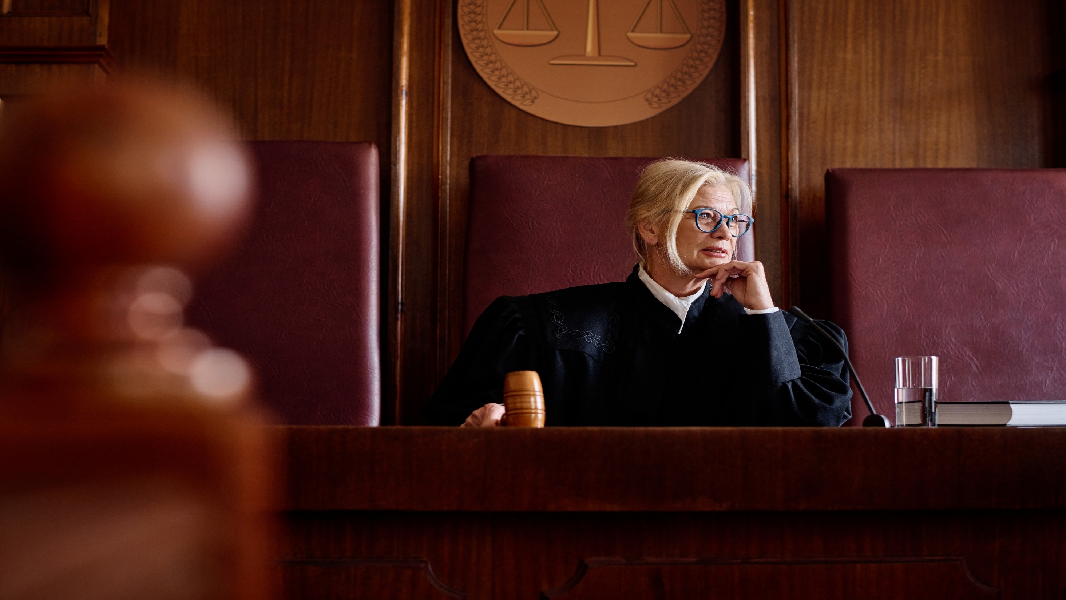
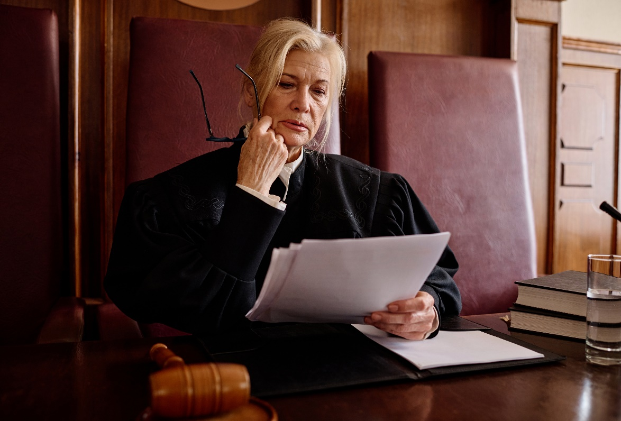
Senior Judges
Senior judges can serve for 10 years or until 78, whichever comes first.
Retired judges who serve as senior judges help ease court backlogs by targeting areas that specifically need help, whether it be from an increased caseload, an unexpected judicial vacancy or when a magisterial district court needs an outside judge because judges in the county have a conflict of interest.
When an MDJ retires, he or she may apply to become a senior MDJ.

Slide 10

How Are MDJs Elected?
The initial election is a partisan election, requiring judges to run as a member of a political party. Once a person is elected as a judge, however, they are precluded from participating in any partisan political activity.
As soon as a person announces their candidacy for judge, they are bound by Pennsylvania’s ethical rules that govern all Pennsylvania judges.
After serving a six-year term, MDJs must run for re-election.
  Since 1989, judicial elections always occur in odd-numbered years.
In Pennsylvania, judges are elected.
When a vacancy occurs (i.e. resignation, death, etc.), the governor may fill the vacancy by temporary appointment, with Senate confirmation. The appointee serves for a term ending the first Monday of January following the next municipal election.

Slide 11

Qualifications
Pa. resident and U.S. citizen
Ages 21-75
MDJs can also be non-lawyers
  Article V, §12 of the Pennsylvania Constitution requires that MDJs be members of the bar of the Supreme Court or, before taking office, complete a course and pass an examination in the duties of their respective office.
MDJs serve 6-year terms.

Slide 12
How are MDJs Educated?
It is the responsibility of the Minor Judiciary Education Board (MJEB) to instruct and certify individuals wishing to become an MDJ and to provide annual continuing education.
In collaboration with the AOPC Judicial Education Department, the Board develops curriculum, arranges for instructors, establishes course content, manages the educational programs, reviews examinations, and issues certificates to successful program participants.
Within the first year of taking the bench, every new MDJ is required to complete the practicum course, “New MDJ School,” equivalent to at least 32 hours of training.
On an annual basis, all MDJs and senior MDJs are required to complete a weeklong continuing education program equivalent to at least 32 hours.
MDJs also participate in supplemental education opportunities such as virtual elective webinars offered by the MJEB and seminars held at the annual Special Court Judges Association Conference.

Slide 13
Where are Magisterial District Courts Located?
Visit AOPC Public Locator Map (pacourts.us à courts à minor-courts) to view an interactive map of all magisterial district courts in Pennsylvania.
  Each Magisterial District Court is assigned a unique court number with the first two digits always representing the specific judicial district, which is typically a single county or in some instances two adjoining counties termed a “joint-judicial district.”

