Slide 1
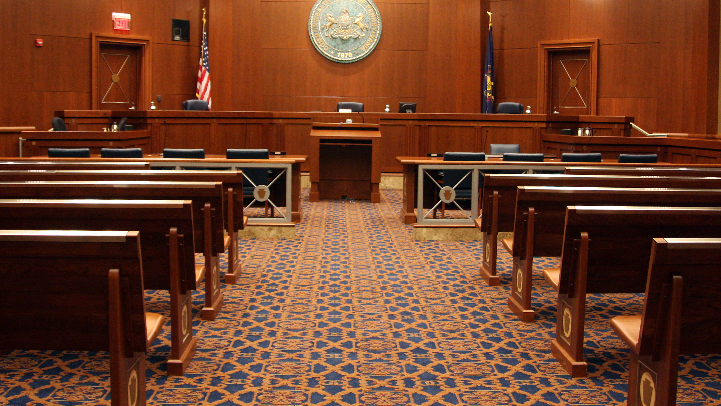
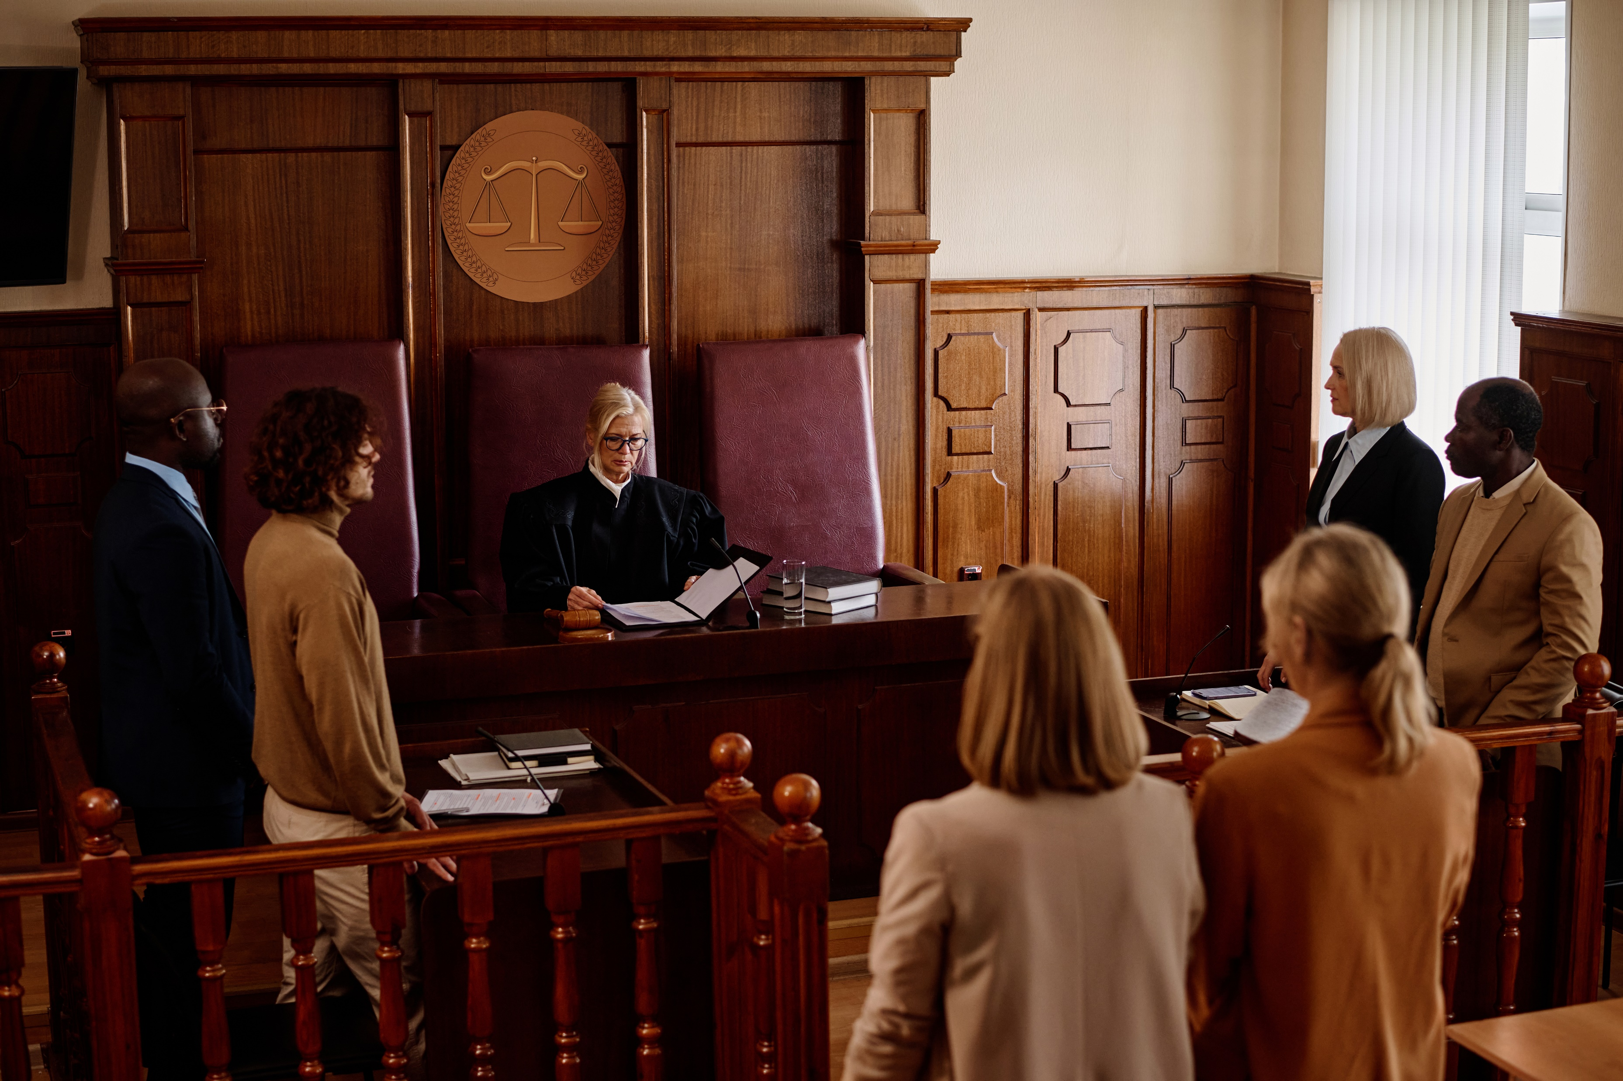
Understanding Pennsylvania’s
Courts of Common Pleas

Slide 2
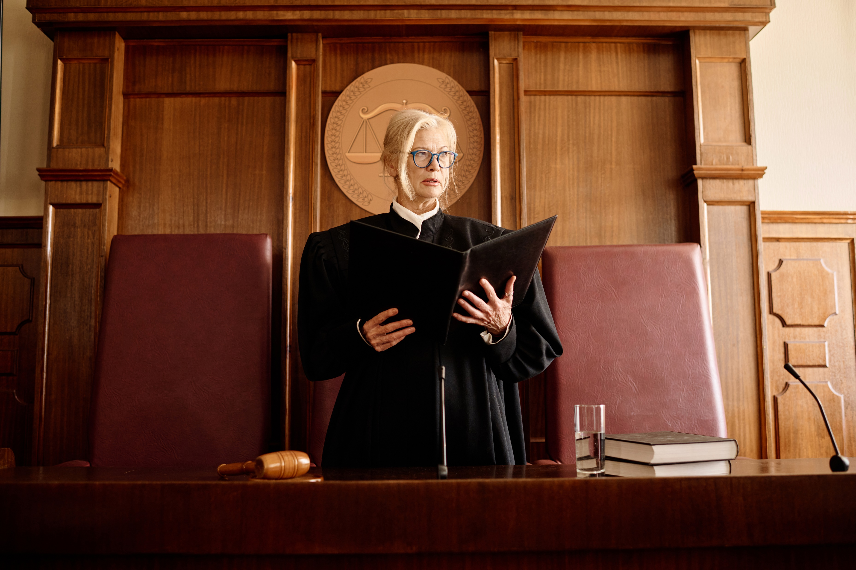
The Courts of Common Pleas hear major civil and criminal cases as well as cases involving children and their families. They also hear appeals from the lower-level courts.
These courts are often referred to as trial courts.

Slide 3
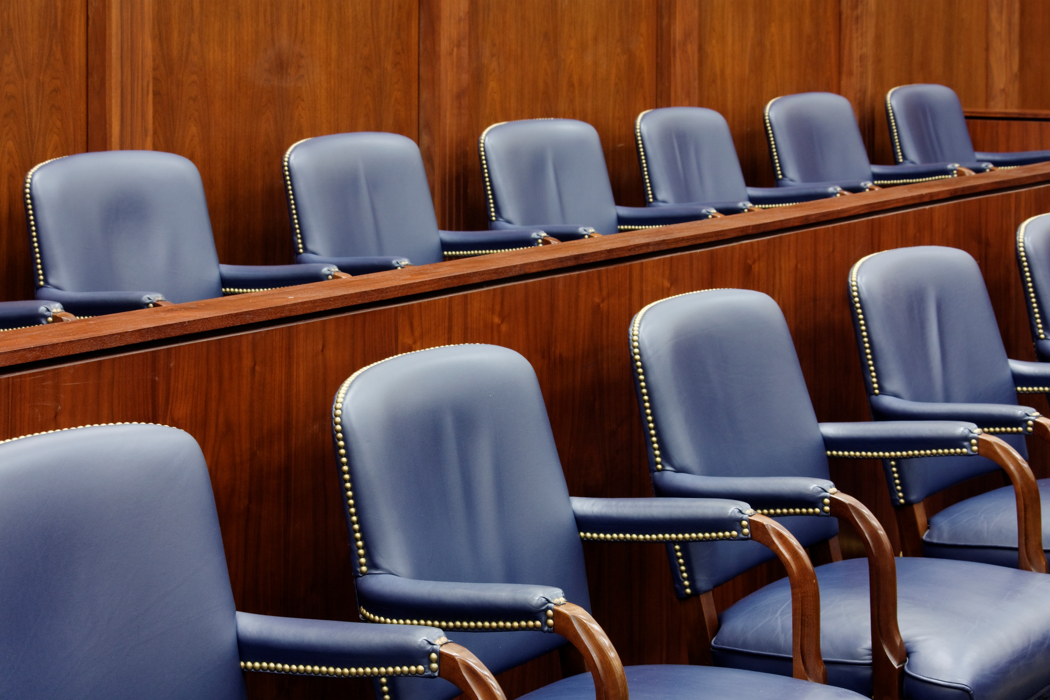
In Pennsylvania, there are 458 trial court judges.
These courts average 700,000 cases per year.

Slide 4

Supreme Court
Superior Court
Commonwealth Court
Courts of Common Pleas
Magisterial District Courts

Slide 5
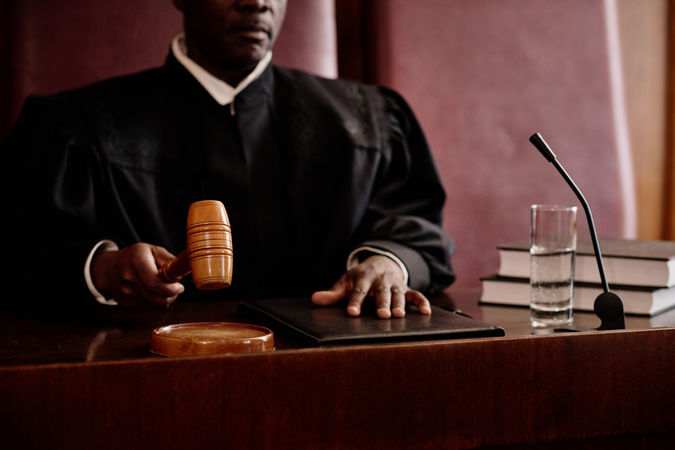
About the Courts
The state’s 67 counties are organized into 60 judicial districts.
  The number of judges in each judicial district varies – ranging from one to 93, depending on population and caseload.
Each Court is led by a president judge, who is responsible for supervising all judges in their judicial district, including the local magisterial district judges, and overseeing administrative tasks.

Slide 6
Types of cases
Criminal Division – Handles serious criminal cases, including felonies (e.g., murder, robbery, drug trafficking) and major misdemeanors (e.g., assault, theft, DUI)
Civil Division – Oversees legal disputes between individuals, businesses, or organizations, including lawsuits (e.g., personal injury, medical malpractice), contract disputes (e.g., breach of agreement), and property conflicts (e.g., boundary disputes, landlord-tenant issues)
Family Division – Deals with legal matters related to family relationships, such as divorce and separation, child custody and visitation rights, child and spousal support, and juvenile delinquency.
Orphans’ Court – Focuses on cases involving wills and estates (handling inheritances and executors), guardianships (appointing legal guardians for minors or incapacitated adults), and adoptions (finalizing the legal process of adoption)

Slide 7

The Role of a Jury
Juries are primarily used in Courts of Common Pleas.
Even when a jury is permitted, both sides can agree to have the case tried before a judge instead.
Criminal | Civil
12 jury members | 8 jury members
A jury decides whether a defendant is guilty or not. | A jury decides whether the defendant is liable or not.
There must be proof beyond a reasonable doubt – placing the burden on the prosecutor to convince the jury of a defendant’s guilt. | The standard of proof is usually based on a preponderance of evidence – meaning the jury weighs the evidence of each side and the party with the weightiest evidence wins the case.

Slide 8
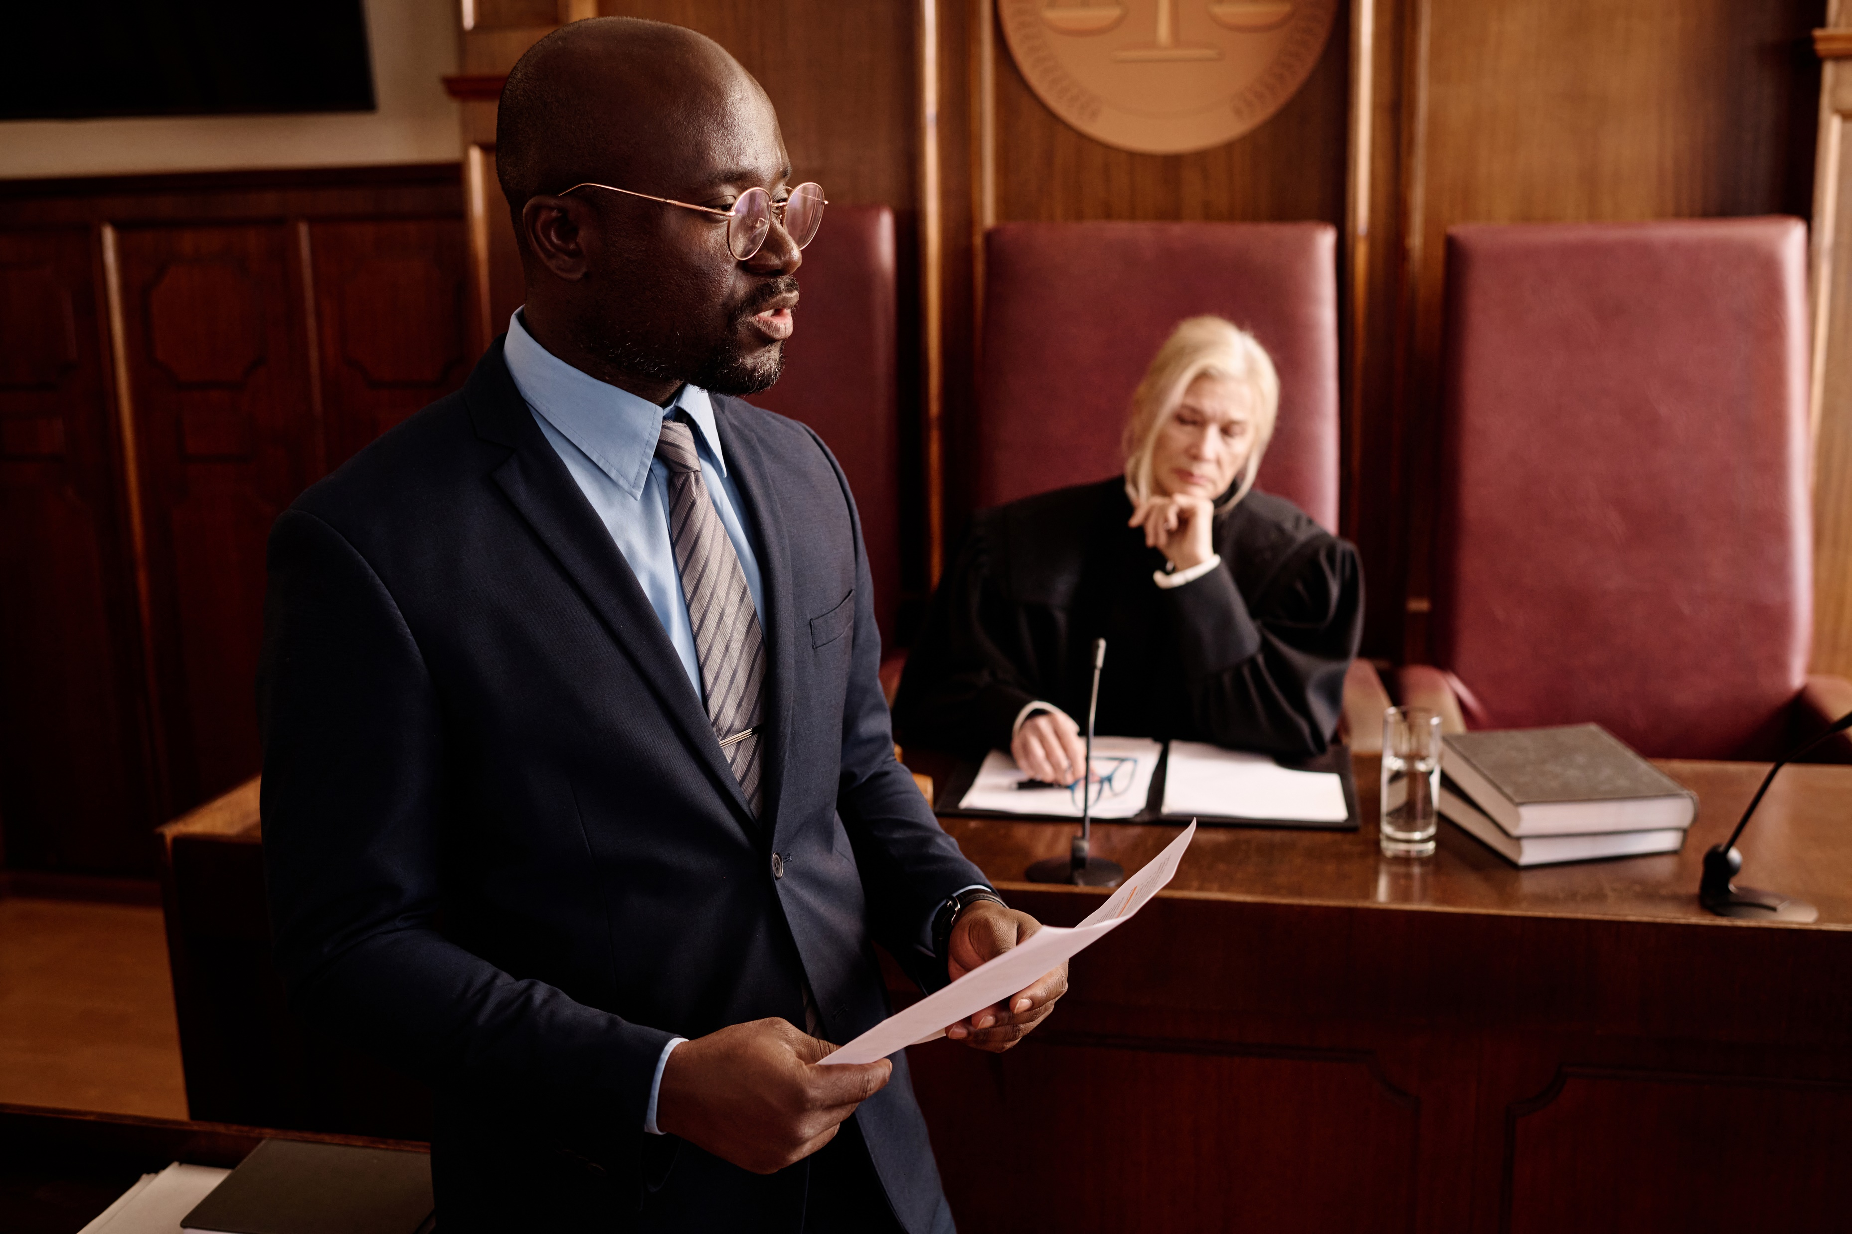
=
How Do the Courts Operate?
Criminal Case Process
Formal arraignment
(final charges received in writing,
guilty or not guilty plea entered)
Pretrial actions
(discovery, motions, pleas)
Pretrial conference
(trial date is set)
Guilty plea Trial by judge or jury Not guilty verdict
(case dismissed)
Presentencing investigation Guilty verdict/conviction
Offender sentenced
Appeal upheld/overturned

Slide 9
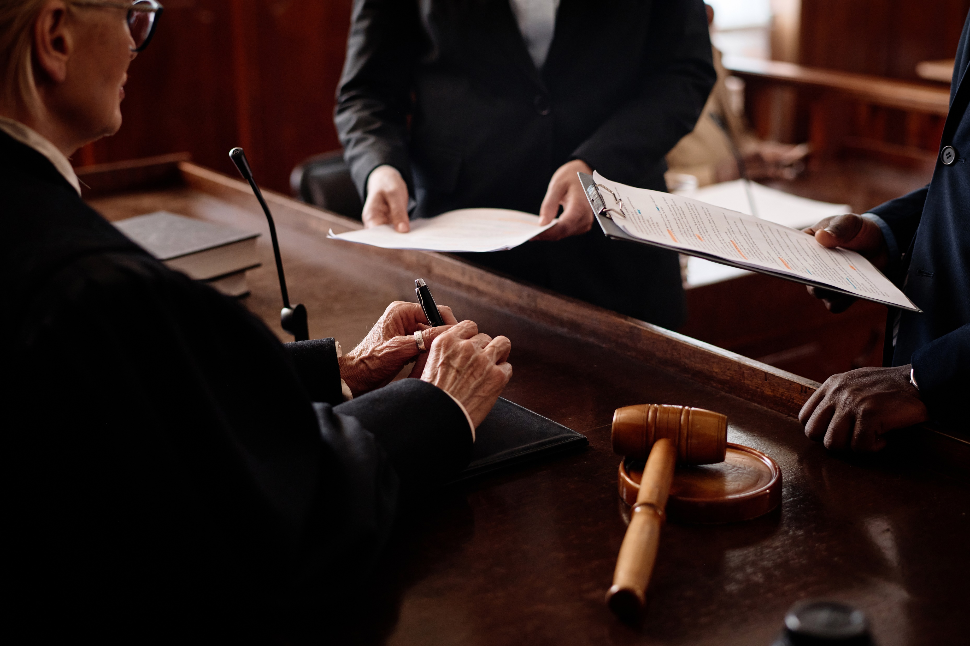
=
How Do the Courts Operate?
Civil Case Process
Dispute develops
Defendant may Complaint is filed Case might be dismissed for
have to answer (defendant is notified) legal reasons
complaint
Discovery process
(both sides gather evidence)
Alternatives to Trial Trial takes place
  Arbitration (losing party can appeal to the appellate courts)
  Mediation
  Settlement

Slide 10
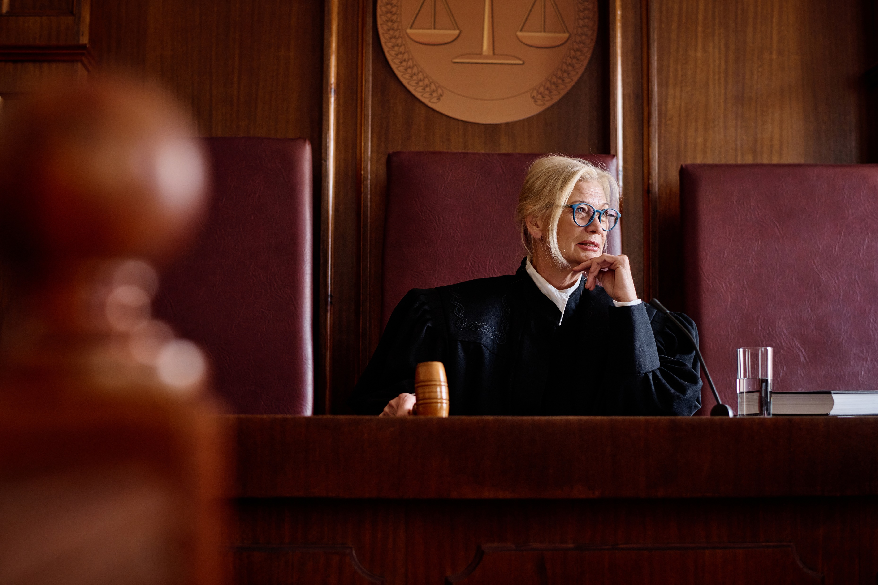
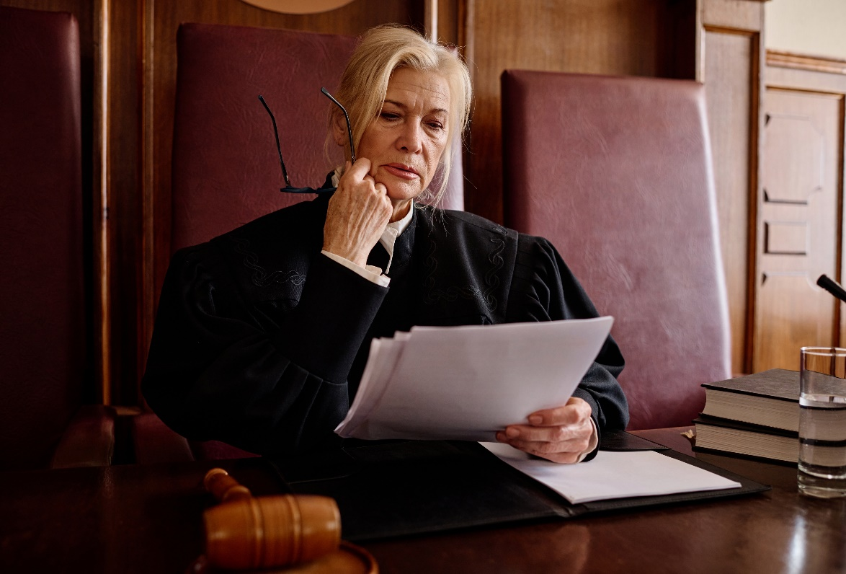
Senior Judges
Senior judges assist the Courts as needed and can serve until age 78.
Retired judges who serve as senior judges help ease court backlogs by targeting areas that specifically need help, whether it be from an increased caseload, an unexpected judicial vacancy or when a common pleas court needs an outside judge because judges in the county have a conflict of interest.
To be eligible for senior certification, a jurist must:
  have served as a judge, whether or not continuously or on the same court, by election or appointment for an aggregate period equaling 10 years
  be at least 65 years of age

Slide 11
How Are Judges Elected?
The initial election is a partisan election, requiring judges to run as a member of a political party. Once a person is elected as a judge, however, they are precluded from participating in any partisan political activity.
As soon as a person announces their candidacy for judge, they are bound by Pennsylvania’s ethical rules that govern all Pennsylvania judges.
After serving a 10-year term, judges run for retention unopposed. Their names appear on the ballot in the fall election, and they are not affiliated with any political party.
    Voters vote “yes” to retain the judge or “no” to remove the judge.
    If a jurist is not retained, the governor has the authority to appoint an interim judge with two-thirds Senate approval. The position is filled permanently in the next judicial election.
    Retention votes only occur in the appellate, Courts of Common Pleas and Philadelphia Municipal Court. They do not occur in Magisterial District Courts.
  Since 1989, judicial elections always occur in odd-numbered years.
Judges are elected,
not appointed, and then stand
for a retention vote.
When a vacancy occurs, the governor may fill the vacancy by appointment, with Senate confirmation. The appointee serves for a term ending the first Monday of January following the next municipal election.

Slide 12
Qualifications
Pa. resident and U.S. citizen
Ages 21-75
State bar member (except MDJs who must be members of the bar or pass a qualifying exam)
Judges serve 10-year terms up to age 75.

Slide 13
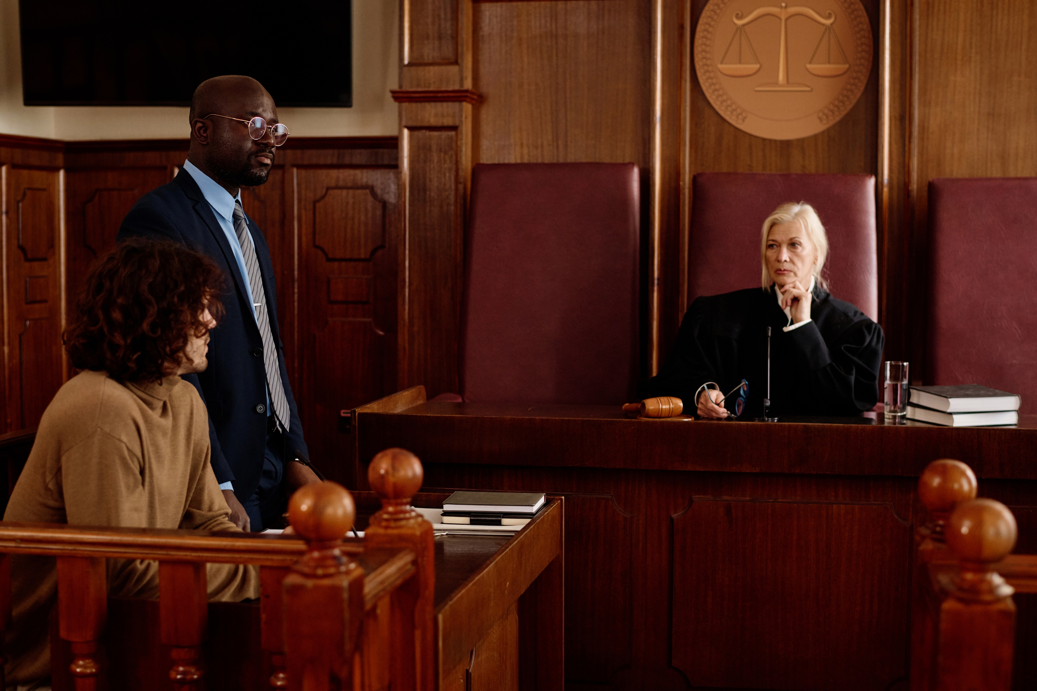
Additionally at this level are problem-solving
courts, which offer rehabilitation programs for
defendants struggling with behavioral problems,
like drug addiction and severe
mental illness
Problem-Solving Courts
Problem-solving courts, or treatment courts, also exist at this level of court. These are specialized courts designed to address underlying issues, such as addiction and mental health disorders, that contribute to criminal behavior.
Instead of focusing solely on punishment, these courts provide rehabilitation and support services with the goal of reducing recidivism.
Types of problem-solving courts:
Drug Treatment Courts
Mental Health Courts
Veterans Treatment Courts
DUI Courts

