Slide 1
Understanding the Courts

Slide 2

The 3 Branches of Government

Slide 3
What is a Court?
A court is a place where we solve problems and make fair decisions.
Judges and lawyers work in courts to make sure everyone follows the rules.
Courts help keep order in our community, just like teachers help keep order in the classroom.

Slide 4
Why do we have rules?
Rules help keep everyone safe and treat people fairly.
Imagine a soccer game with no rules – it would be chaos!
Courts help decide what to do if someone breaks a rule.

Slide 5
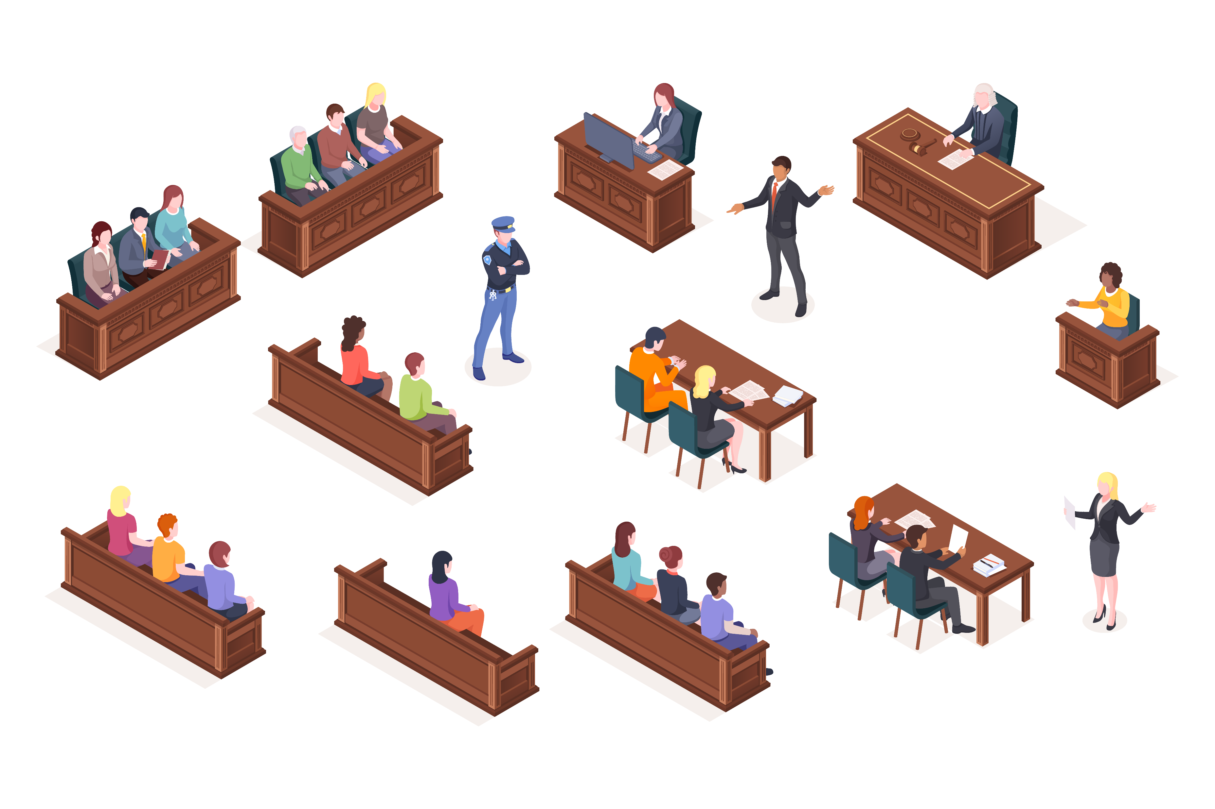
Who is in the Courtroom?
Judge: That’s me! I listen and help make fair decisions.
Lawyers: They help people explain their side of the story.
Jury: A group of people who help decide some cases.
Police Officers & Witnesses: They share important information.

Slide 6



What kind of cases do courts handle?
  Traffic cases: Like speeding or running a red light.
  Family cases: Like adoption or helping kids find safe homes.
  Criminal cases: If someone breaks an important law.
  Did you know? Not all cases go to court. Many are solved by talking first.

Slide 7

Different types of courts
Supreme Court: The biggest and most important court in Pennsylvania!
Superior Court: Hears cases when people don’t agree with a decision.
Commonwealth Court: Handles cases about state rules and laws.
Common Pleas Courts: Handles everyday cases like family and community issues.
Magisterial District Courts: Helps with small problems and decisions.

Slide 8
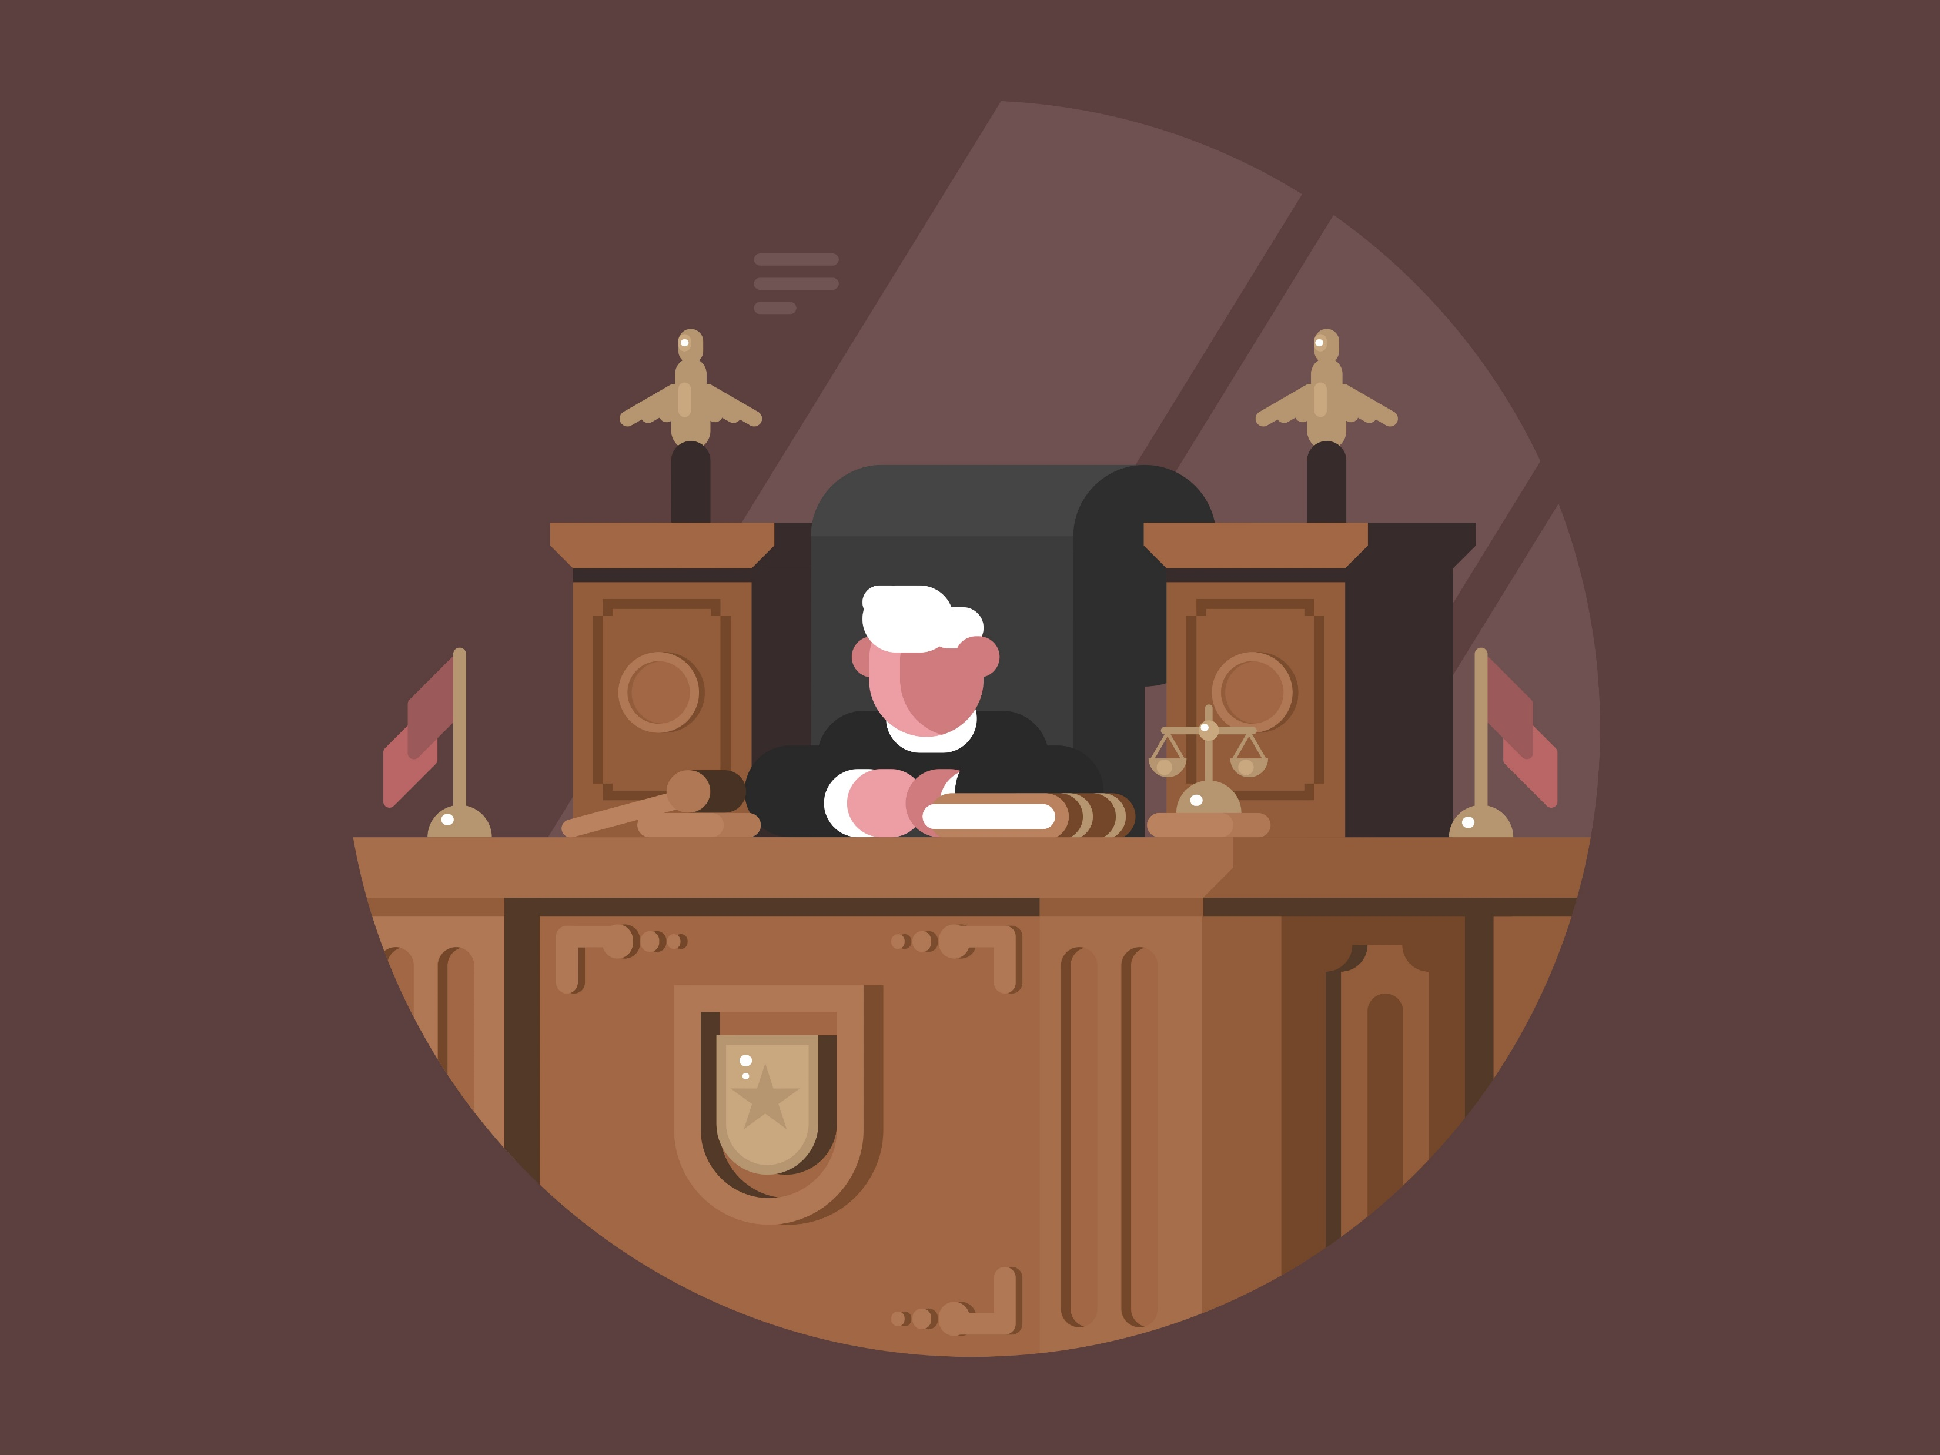
Day of a Judge
Listens carefully during trials and hearings
Instructs the jury
Review legal documents
Evaluates evidence to determine guilt
Writes clear decisions and orders

Slide 9
How a case works
Someone has a problem and asks the court for help.
A judge listens to both sides.
The judge (or jury) makes a fair decision.
Everyone must follow the court’s decision.

Slide 10
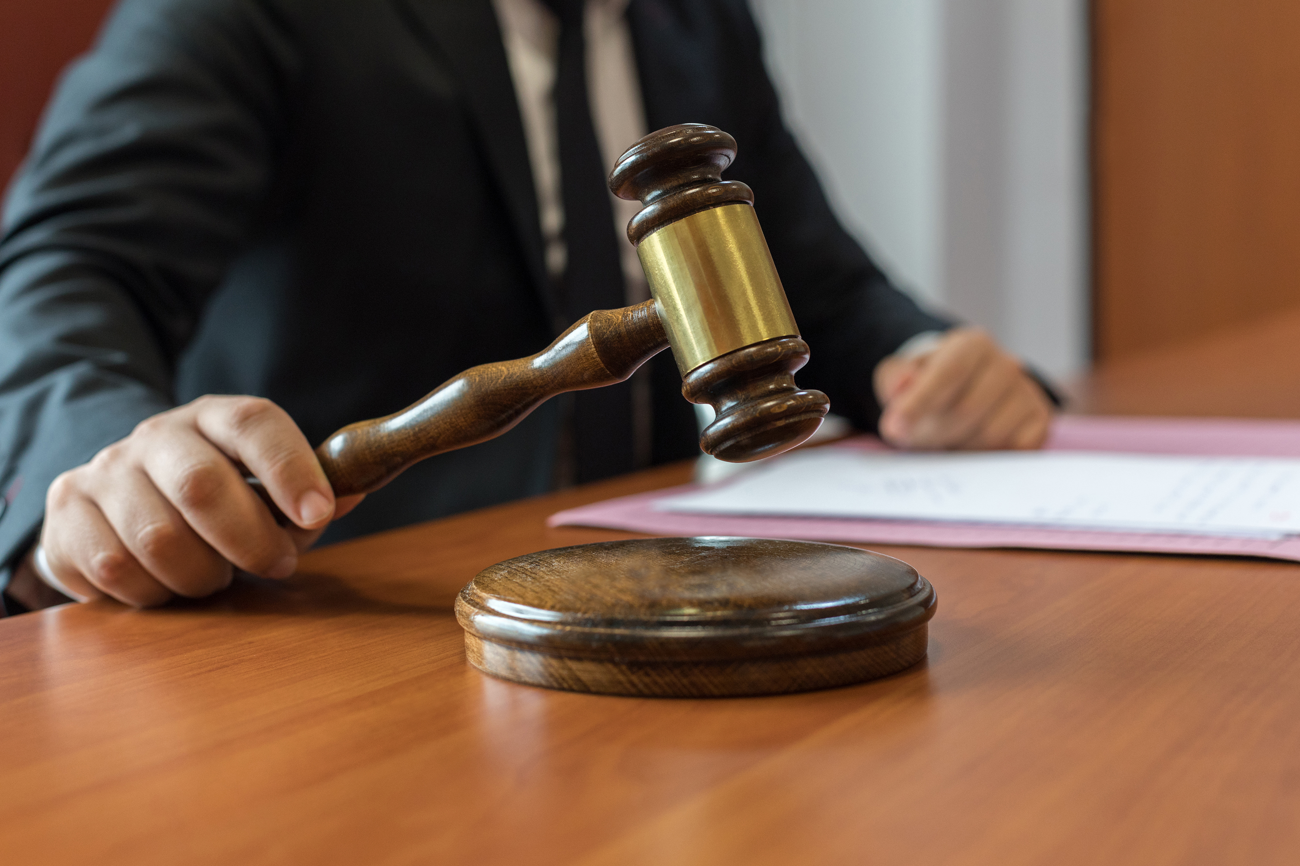
Let’s play judge
Case #1
Someone took an extra turn in a game. What should happen?
Case #2
Your friend says you broke a rule, but you didn’t mean to. How do you solve it fairly?

Slide 11
How can YOU be fair?
Listen to both sides before making a decision.
Be honest and tell the truth.
Follow the rules at school, at home, and in games.

Slide 12
Flat Judge

Slide 13
Thank you!

